Slide 1
Milwaukee Pension Management Center
Updated: April 2026 (Milwaukee PMC QRT)

Slide 2
Pension Overview Topics
Contact Information
Jurisdiction of the PMCs
The Basics
Service
Income
Net Worth
Dependency
Permanent and Total Disability
Special Monthly Pension
Maximum Annual Pension Rate (MAPR) Chart
Specific Forms
How to Apply – Intent to File
Medical Expenses
VA Representatives and VA Form 21-22
PACT Act overview
Questions

Slide 3
Jurisdiction of the PMCs
National Work Queue (NWQ) routes EPs with a claim label that includes PMC prefixes to a PMC without regard for state of residence, based on approved NWQ routing rules.
PMC claims involving a decision for service-connected (SC) death or burial, to include error corrections, are the jurisdiction of the Philadelphia PMC.
Once a SC death decision is granted, subsequent claims are the jurisdiction of the Milwaukee and St. Paul PMC.
The Philadelphia Veterans Service Center (VSC) has sole jurisdiction over all original in-service death claims, to include in-service death claims received from multiple claimants prior to the adjudication of the original claim.
The Philadelphia PMC has jurisdiction over all non-original in-service death claims received after the adjudication of the original claim.
Applicable References: M21-1 I.ii.1.B.2.b. Jurisdiction of the PMCs; M21-1 II.ii.3.1.b. Jurisdiction of Claims Involving a Special Mission or Circumstance

Slide 4
Contact Information
Contact the National Contact Center (NCC) to inquire about the current status of EXPEDITED claims. 1-855-225-0709. The NCCs Veteran Service Organization (VSO) Hotline is a national hotline used by VSO representatives to assist beneficiaries in collecting, submitting, and managing inquiries submitted on their behalf. The NCC VSO line is for VSOs only and is answered from 8:00 AM to 9:00 PM Eastern, Monday – Friday, except for holidays.
We consider the following to be Priority Claims requiring expedited processing:
Medal of Honor
Homeless
Terminal Illness
POW, GWOT, Seriously Injured (SI)/Very Seriously Injured (VSI)
Medical Foster Home
Severe Financial Hardship
Age 85 and over - If receiving or applying for Compensation benefits.

Slide 5
Contact Information, continued
The Milwaukee PMC has an email address FOR VSOs to inquire about the current status of all other claims and ask general questions.
The email is: PMCVSO.VBAMIW@va.gov
This email is answered by the Coach of the Advocacy Team.
All general claim questions should be routed here.
Allows the PMC to research answers and send something to you in writing.
Allows the PMC to forward all information to the proper division/department quickly.

Slide 6
Contact Information, continued: Centralized Mail
The Milwaukee PMC moved to Centralized Mail effective February 28, 2016
PO Box 342000 was closed effective February 29, 2016
The Centralized Mail address for the Milwaukee PMC:
Pension & Survivors Benefits
Department of Veterans Affairs
Pension Intake Center
P.O. Box 5365
Janesville, WI 53547
FAX: 1-844-655-1604

Slide 7
The Basics – Eligibility Requirements
Pension is a needs-based benefit paid to those meeting certain criteria related to:
Service
Must have been Under Other Than Dishonorable conditions.
Wartime Service
Minimum Active-Duty Service
Applicable References: M21-1 II.iii.1.B.1.d. Eligibility Determinations for Pension; M21-1 IX.i.1.2.a. Wartime Service Requirement for Veterans Pension; M21-1 IX.i.1.2.c. Pension Wartime Periods Table; M21-1 III.i.1.B.1.a. Minimum Active Duty Service Requirements

Slide 8
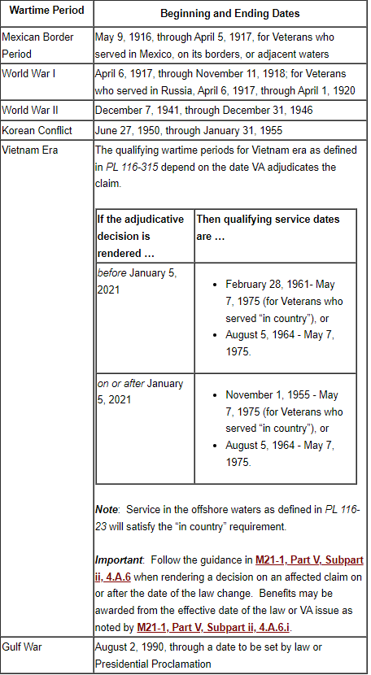
The Basics – Eligibility Requirements (continued)
The following table provides the beginning and ending dates of qualifying wartime periods for pension benefits (M21-1 IX.i.1.2.c. Pension Wartime Periods Table):

Slide 9
The Basics - Eligibility Requirements (continued)
Pension is a needs-based benefit paid to those meeting certain criteria related to:
Income
All income (including income of dependents) is countable unless specifically excluded by 38 CFR 3.272.
Expenses may be used to reduce countable income.
The amount of a claimant’s countable income for VA purposes (IVAP) determines the VA benefit rate payable (the higher the IVAP, the lower the benefit rate).

Slide 10
The Basics - Eligibility Requirements (continued)
Net Worth
Bright Line Net Worth limit is $163,699.00 effective December 1, 2025
If calculated NW exceeds the limit, then it is a bar to benefits
Net worth, on or after October 18, 2018, is the sum of a claimant’s assets and Income for VA Purposes (IVAP)
Assets do not include the value of a primary residence and personal effects suitable and consistent with a reasonable mode of life, such as automobiles.
Background Information:
Derives from Community Spouse Resource Allowance (CSRA) for Medicaid purposes
Indexed for inflation
Will change annually by SSA COLA increases

Slide 11
The Basics: Continued (Net Worth)
VA pension is a needs-based benefit and is not intended to preserve the estates of individuals who have the means to support themselves. Accordingly, a claimant may not create pension entitlement by transferring covered assets. VA will review the terms and conditions of asset transfers made during the look-back period to determine whether the transfer constituted transfer of a covered asset.
A Look-back period means the 36-month period immediately preceding the date on which VA receives either an original pension claim or a new pension claim after a period of non-entitlement. The look-back period starts from the date a formal claim is submitted after a period of non-entitlement. A look-back period does not start from the date of an Intent to File (M21-1 IX.iii.1.J.5.b.)
Annuities, Trusts, or Other Similar Financial Instruments as Net Worth
VBA is to count the total value of an annuity, trust or other similar financial instrument as an asset if the claimant establishes the ability to liquidate the entire balance.
If the claimant cannot liquidate the value of the annuity trust or other similar financial instrument or information about the liquidity of an annuity is unavailable, count the monthly income received as income for net worth purposes and exclude the financial instrument value from assets.
If you have the information available, please submit evidence showing the total cash value (as of the date of claim) of an annuity, trust, or other similar financial instrument up front/along with the claim. This will help VBA make a timelier decision and potentially mitigate any development that may be necessary to promulgate the claim.

Slide 12
The Basics, continued
Dependency (Spouse/Children)
Required to report dependents because their income and net worth must be considered when determining benefits.
Additional allowance given for dependents
Permanent and Total Disability (Veterans only)
Presumption (e.g. Age 65 and older, in receipt of Social Security Disability, is a patient in a nursing home for long-term care because of a disability)
More often than not, PMCs are able to grant permanent and total (P&T) disability for non-service connected pension purposes presumptively, based on the above examples.
If they do not meet the presumptive criteria, then medical evidence must show the Veteran is P&T by rating decision (see below).
Medical evidence
Veterans either must be evaluated in a rating decision at 60% or higher for a single disability, or at least 70% with combined disabilities, with one disability evaluated at least at 40%.
Where the evidence of record fails to meet the disability requirements based on the percentage standards of the rating schedule but is found to be unemployable by reason of his or her disability(ies), age, occupational background and other related factors, P&T disability may be reviewed on an extra-schedular basis per 38 CFR 3.321 (b)(2).

Slide 13
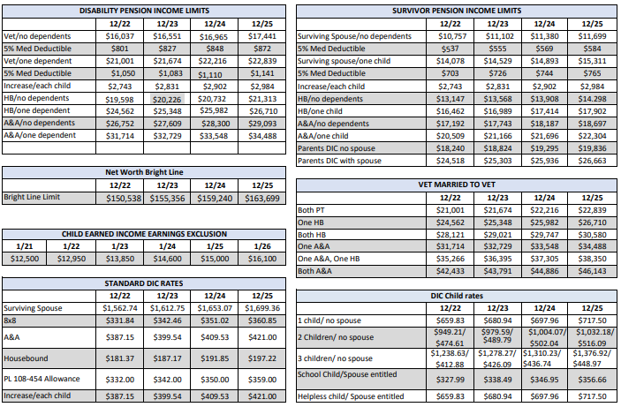
Maximum Annual Pension Rate (MAPR) Chart

Slide 14
The Basics, continued
Special Monthly Pension (SMP)- Additional benefit payable to Veterans and survivors based on meeting certain criteria.
Aid and Attendance (granted by rating or administratively per 38 CFR 3.351)
Requires the aid of another person to perform activities of daily living,
Be blind or meet other specific visual acuity requirements, or
Be a patient in a Nursing Home or State Veteran’s home. ( VA Form 21-0779, Request for Nursing Home Information in Connection With Claim For Aid And Attendance, should be submitted)
Housebound (granted only by rating)
Medical evidence must be submitted showing condition(s) is/are severe enough to render housebound, or
Medical evidence dated within the last year or lists treatment at a VAMC.
To apply for either benefit by rating, please submit VA Form 21-2680, Examination for Housebound Status or Permanent Need for Regular Aid and Attendance

Slide 15
How to Apply
VA Pension Prescribed Forms Checklist - Please only use most current version of form to avoid any delay in claims processing
Veterans Pension (Original)
21P-527EZ, Application for Veterans Pension
Survivors Benefits(Original)
21P-534EZ Application for DIC, Survivors Pension, and/or Accrued
21P-535, Application for Dependency and Indemnity Compensation by Parents

Slide 16
Survivor Benefits
Survivors Pension- Surviving Spouse, Children
VAF 21P-534EZ, Application for Dependency and Indemnity Compensation , Pension, and/or Accrued
Month-of-Death Benefits- Surviving Spouse
No prescribed form
Dependency and Indemnity Compensation (DIC)- Surviving Spouse, Children, Parents
VAF 21P-534EZ, Application for DIC, Pension, and/or Accrued
VAF 21P-534a, Application for DIC by a Surviving Spouse or Child- In-Service Death Only
VAF 21P-535, Application for DIC by Parents
DEA
VAF 22-5490, Dependent’s Application for VA Education Benefits
CHAMPVA- https://www.va.gov/COMMUNITYCARE/index.asp
Health Administration Center Denver, CO, 1-800-733-8387
Fry Scholarship (Service Member who die in the line of duty after 9/10/01)
www.benefits.va.gov./gibill/index.asp
Home Loan Guaranty- www.homeloans.va.gov
VAF 26-1880, Request for a Certificate of Eligibility

Slide 17
Survivor Benefits, continued
Burial Benefits – www.cem.va.gov
VAF 21P-530EZ, Application for Burial Benefits
VAF 40-0247, Presidential Memorial Certificate Request Form
VAF 40-1330, Claim for Standard Gov’t Headstone or Marker
VAF 40-1330M, Claim for Gov’t Medallion for Placement in a Private Cemetery
VAF 27-2008, Application for U.S. Flag for Burial Purposes
Accrued Benefits- paid based on relationship or reimbursement
VAF 21P-534EZ, Application for Dependency and Indemnity Compensation , Pension, and/or Accrued
VAF 21P-601, Application for Accrued
VAF 21P-0847, Request for Substitution of Claimant Upon Death of claimant-may also be used as a prescribed form for accrued benefits if submitted by a surviving spouse and the substitution determination results in the claimant being recognized as a valid substitute.

Slide 18
How to Apply, continued
Income Adjustments For Running Awards or to Supplement Initial Applications:
21P-0512S-1, Old Law and Section 306 Eligibility Verification Report (Surviving Spouse)
21P-0512V-1, Old Law and Section 306 Eligibility Verification Report (Veteran)
21P-0513-1, Old Law and Section 306 Eligibility Verification Report (Children Only)
21P-0514-1, DIC Parent’s Eligibility Verification Report
21P-0516-1, Improved Pension Eligibility Verification Report (Veteran with No Children)
21P-0517-1, Improved Pension Eligibility Verification Report (Veteran with Children)
21P-0518-1, Improved Pension Eligibility Verification Report (Surviving Spouse With No Children)
21P-0519C-1, Improved Pension Eligibility Verification Report (Child or Children)
21P-0519S-1, Improved Pension Eligibility Verification Report (Surviving Spouse With Children)

Slide 19
How to Apply, continued
- 21P-8416, Medical Expense Report
- 21P-8416b, Report of Medical, Legal, and Other Expenses Incident to Recovery for Injury or Death
-21P-0571, Application for Exclusion of Children’s Income
- 21-8049, Request for Details of Expenses
-21P-4165, Pension Claim Questionnaire for Farm Income, and
-21P-4185, Report of Income from Property or Business.

Slide 20
How to Apply: Intent to File
Claimants desiring the benefit of filing an informal claim are required to communicate an “intent to file” (ITF). This may be completed by:​
Submitting a completed VA Form 21-0966, Intent to File a Claim for Compensation and/or Pension, or Survivors Pension and/or DIC​
Contacting a National Call Center at 1-800-827-1000
Initiating an application for benefits via a VA claims submission service website
Contacting a Veterans Service Center (VSC)/Pension Management Center (PMC) employee by telephone or in person​

Slide 21
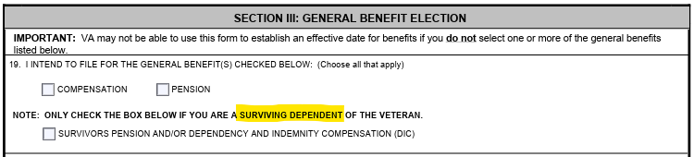
How to Apply: Intent to File, continued
VA Form 21-0966, Intent to File, must be signed by the claimant, VSO, or VA recognized POA and must provide enough information to identify the claimant and specify the benefit they are seeking.
**Please note, the boxes for compensation and pension are for Veterans only, and the Survivors Pension and/or DIC box is the only box that can be checked by a survivor.
The claimant then has one year from the date of receipt of the ITF to provide a complete application. If a claimant submits another intent to file (ITF) for the same benefit claimed on the original ITF within one year of the original ITF, we will only consider entitlement from original ITF.

Slide 22
How to Apply, continued
Recommendations to speed up claims process:
Certify photocopy of discharge document using VSO stamp.
Completely fill out forms, leave no items blank
Example: On income sections of VA Form 21-527EZ, do not leave any items blank. If no income was received from a particular source, write “0” or “none.”
On both the VA Form 527EZ/534EZ, Section IX – you may be required to complete VA From 21P-0969 (Income and Asset Statement in Support of Claim) if questions are answered ‘Yes’.
If claimant wants consideration for SMP must specifically claim with original claim or be written on VA Form 21-0966. Notice of nursing home status may not be sufficient
Submit VAF 21-2680 or VAF 21-0779
State claiming SMP on application, fax coversheet, VAF 4138
Hand write on Intent to File

Slide 23
How to Apply, continued
Alternate Signature (if necessary)
M21-1 II.i.2.B.3. Procedures for Alternate Signers - This section of the manual outlines individuals authorized to sign on behalf of a claimant, requirements for an alternate signer, handling a form or application with an alternate signature.
The 527EZ and 534EZ have been updated to include Section XIV (Alternate Signer Certification and Signature)
If the alternate signer certification section of the form is filled out satisfactorily (per the Procedures for Alternate Signers outlined in the manual), the signature will be accepted without further development. Since the instructions on the form do not specify that a VA Form 21-0972 is needed, a VA Form 21-0972 is not required. By signing in this section of the updated application, the alternate signer is certifying both the relationship to the claimant and the reason the claimant cannot sign on their own.
Per 38 U.S.C 5101, a fiduciary can sign any form on behalf of a claimant, to include a VA Form 21-22, Appointment of Veterans Service Organization as Claimant’s Representative.

Slide 24
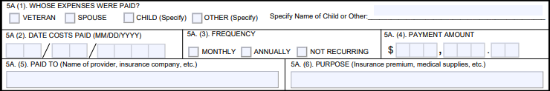
Medical Expenses
Beneficiaries are allowed to submit medical expenses to reduce their available income. Medical expense adjustments are now required to be submitted on VA Form 21P-8416.
If the VA Form 21P-8416 is incomplete, it requires development which will delay the claims process.

Slide 25
Medical Expenses, continued
Expenses will be considered either:
Continuing medical expenses (CMEs) which are counted on a continuous basis (considered projectable), or
Unreimbursed medical expenses (UMEs) are counted for the period in which they were paid. (must wait to report until after they have been paid)
Continuing medical expense examples:
Medicare Part B,
private medical insurance,
assisted living or nursing home fees,
oxygen,
incontinence supplies
Unreimbursed medical expense examples:
doctor co-pay,
OTC supplies,
prescription expenses,
one-time medical supply expense like a cane or walker

Slide 26
Medical Expenses, continued
A VA Form 21P-8416, along with an expense statement, is now required for claiming facility or care fees.
Nursing home, assisted living, in home caretakers
If applicable, please make sure to complete the “Worksheet for a Residential Care, Adult Daycare, or a Similar Facility” or “Worksheet for In-Home Attendant Expenses,” which are supplemental attachments for both the 527EZ and 534EZ. If submitting the “Worksheet for In-Home Attendant Expenses,” you would not need to send in a separate 4138 or other form to report in-home care expenses.
If a claimant with a running award moves from one facility to another, an updated VA Form 21P-8416 along with an expense statement is required.
If a claimant moves in to a facility for the first time, a VA Form 21P-8416, expense statement from facility, and a document to support the claim for special monthly pension is required.
Examples of common forms in addition to VA Form 21P-8416 are:
VA Form 21-0779 - for a presumptive grant based on residing in a nursing home
VA Form 21-2680 – used for a rating decision to grant special monthly pension

Slide 27
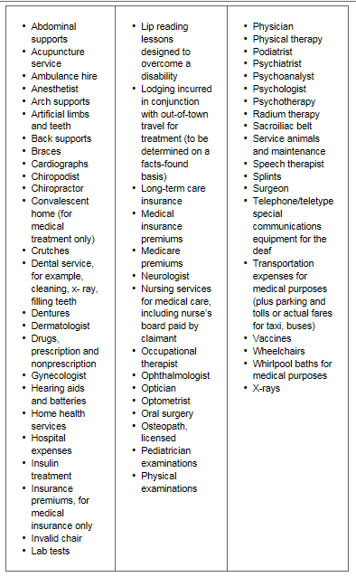
Medical Expenses, continued: Common Examples of Medical Expenses

Slide 28
VA Representatives
Claimants before VA are provided representation by Veterans service organizations (VSOs), attorneys, agents, and other accredited individuals to ensure that such claimants have responsible, qualified representation to assist in the preparation, presentation, and prosecution of claims for Veterans’ benefits.
Claimants may appoint a single representative for all claims or they may choose to appoint a different representative on a limited basis for a particular claim.
VA representation means broadly that an individual has completed legal formalities to authorize a VSO, attorney, agent, or individual to perform functions on his or her behalf in business before VA.

Slide 29
Declaration of Representation Requirements
An accredited representative of a VSO may represent a claimant if VA receives a properly completed and executed VA Form 21-22, Appointment of Veterans Service Organization as Claimant’s Representative, that shows the service organization as representative.
An accredited attorney or agent may represent a claimant if VA receives a properly completed and executed VA Form 21-22a, Appointment of Individual as Claimant’s Representative.
A non-licensed individual may represent a claimant if VA receives a declaration of representation that complies with the provisions outlined in 38 CFR 14.630 to include a properly completed and executed VA Form 21-22a. The representation is for a one-time, one-claim basis only.
These forms must be signed by the claimant. However, we are now able to accept an alternate signature on this form, as long as it is received with VA Form 21-0972, Alternate Signer Certification.

Slide 30
What Constitutes a Complete VA Form 21-22?
For the VA Form 21-22 to be considered complete, it must contain the following information:
Enough information to identify the Veteran/claimant
The name of the service organization,
Signature of the Veteran/claimant with a corresponding date of signature, and
Signature of the representative acting on behalf of the service organization with a corresponding date of signature.
Note: There is no need to verify that the specific representative listed in Block 3B of VA Form 21-22 is accredited. This form documents the appointment of the entire service organization listed in Block 3A and does not indicate the designation of only the specific representative to act on behalf of the organization.

Slide 31
Appeals Modernization Act (AMA)
On August 23, 2017, the Veterans Appeals Improvement and Modernization Act of 2017 was signed into law.
The new law modernized VA’s claims and appeals process. It includes:
Review options for Veterans who disagree with VA decisions
Changes to VA’s duty to assist requirements
Improved decision notice requirements for all VA decisions

Slide 32
AMA – Review Options
The law created a new decision review process. It features three lanes:
Higher-Level Review (VA Form 20-0996)– An entirely new review of the claim by an experienced adjudicator
One year filing deadline
“De novo” (starting from the beginning) review with full different of opinion authority – replaced historical DRO review process
Supplemental Claim (VA Form 20-0995)– An opportunity to submit additional evidence
No filing deadline. However, to preserve effective date, it must be filed within one year
Appeal (VA10182)– Review by the Board of Veterans’ Appeals
One year filing deadline

Slide 33
AMA – Overview of Review Options
Multiple options for Veterans/representatives:
Use one lane at a time for a claimed issue
Choosing one lane over another does not prevent the Veteran/representative from later choosing a different lane
There are no limits to the number of times a Veteran may pursue a claimed issue in any of the given lanes
Effective date for benefits – Always protected if the Veteran pursues the same claimed issue in any of the lanes within one year
Note, in order to take an alternate signature on these forms, VA Form 21-0972, Alternate Signer Certification, must be of record or received with it.

Slide 34
AMA Impact on Regular Claims Processing
AMA regulations provided new definitions for claims:
Initial Claim – Substantially complete claim, other than a supplemental claim, for a benefit on a form prescribed by the Secretary, including an original claim and a subsequent claim for a new benefit, new disability or increase
Supplemental Claim – Substantially complete claim for a VA benefit on an application form prescribed by the Secretary where an initial claim or supplemental claim for the same or similar benefit on the same or similar basis was previously decided
PMCs can accept claims submitted on the proper standard form at any time. These are initial claims unless they are submitted as evidence in support of another pending claim. The effective date and time limits for reports of income and net worth changes has not changed with AMA. To readjudicate a claim for pension that was denied for a reason other than income, VBA requires a supplemental claim to preserve an earlier effective date. Some examples include denials for failure to submit death certificate and failure to provide acceptable evidence of military service.

Slide 35
AMA References
A list of applicable AMA references (not all inclusive) is below:
38 CFR 3.2500 - Review of decisions
38 CFR 3.2501 - Supplemental claims
AMA FAQs – PMC (Available in the CPKM/Manual)
M21-1 II.iii.2.B – Supplemental Claims

Slide 36
New Issues: The PACT Act
The Philadelphia PMC handles claims involving a decision for service-connected (SC) death or burial.
Once a SC death decision is granted, subsequent claims are the jurisdiction of the Milwaukee and St. Paul PMC.
Milwaukee and St. Paul PMCs will continue to review non-service connected death claims (e.g. survivor’s pension) for potential entitlement under the PACT Act.
This may involve additional development that has been identified with PACT Act related issues, such as presumptive cause(s) of death with indication of possible service in a presumptive location established by PACT Act, or non-presumptive cause(s) of death with verified, or possible, participation in a TERA.
Claims regarding service-connected death benefits may have an effective date earlier than August 10, 2022.

Slide 37

Questions?

