Slide 1

Understanding Military Duty Status… Without Losing Your Sanity!
An Expanded Guide with Humor and Clarity

Slide 2
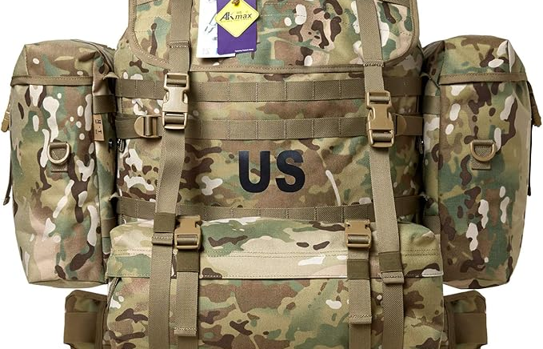

Title 10
When Uncle Sam says, 'Pack your bags, you're active duty now!'
Notes:
Title 10 means federal active duty. Explain that the service member falls under federal command. Use humor about how Title 10 often means packing bags quickly and embracing 'big Army/Air Force' life.

Slide 3

Title 32
When you're federal... but also state... basically, you're both. Like a dual‑boot human.
Notes:
Title 32 is state-controlled but federally funded. Clarify that Soldiers still work for the Governor but follow federal training/mission standards. Add a joke about being 'both state and federal, depending on who’s asking.'

Slide 4

State Active Duty (SAD)
When the Governor needs you because things got spicy in the state.
Notes:
Explain that SAD is fully state-controlled, often used for emergencies like floods or civil support missions. Add humorous remarks about weather-related call-outs at inconvenient times.

Slide 5

ADOS
Temporary active duty: like borrowing a Soldier full‑time, but with more paperwork.
Notes:
ADOS orders bring Guard or Reserve service members on temporary active duty. Use humor about short-term assignments turning into long-term projects because ‘the Army loves extensions.’

Slide 6

M-Day (Drill Status Guardsman)
One weekend a month, two weeks a year... and about 400 texts from your unit.
Notes:
Clarify that M-Day members serve part-time. Insert a joke about drill weekends consuming far more than 'one weekend a month.'

Slide 7

AGR
Full-time Soldier, full-time coffee consumption.
Notes:
Explain AGR as full-time active duty within the Reserve components. Add humor about AGR Soldiers being the glue that keeps everything functioning… along with caffeine.

Slide 8

IDT (Inactive Duty Training)
When you train, but apparently, you're still 'inactive.' Makes total sense.
Notes:
IDT refers to training performed while not on active duty—usually drill periods. Add humor about being ‘inactive but somehow still busy.’

Slide 9

AT (Annual Training)
The magical two weeks where civilian jobs pretend to miss you.
Notes:
AT is the required yearly training period. Add light humor about AT always seeming to land during family birthdays or major events.

Slide 10

MPA Orders
When the Air Force says, 'We need help, but only for a little while.'
Notes:
MPA orders are Air Force-specific active duty support. Add humor about how the Air Force makes even temporary duty sound fancy.

Slide 11

TDY
Temporary Duty: Basically, military travel... with none of the vacation perks.
Notes:
TDY is a temporary duty assignment away from home station. Add humor about per diem calculations and confusing travel itineraries.

Slide 12

Mobilization
When the military says 'SURPRISE! You're going somewhere.'
Notes:
Mobilization refers to preparing and sending Soldiers for extended missions. Add humor about last-minute packing and chaotic timelines.

Slide 13

Deployment
Pack everything. Then unpack half because you're over the weight limit.
Notes:
Deployment means long-term overseas service. Add humor—respectfully—about the universal struggle with packing lists and weight limits.

Slide 14
VA Claims Impact – Title 10
Title 10 service counts as federal active duty, making it fully eligible for VA disability claims. Injuries and conditions incurred or aggravated during this period are straightforward to claim.
Notes:
Explanation of how Title 10 affects eligibility for VA disability claims. Stress documentation, LODs, and clarity in duty status.

Slide 15
VA Claims Impact – Title 32
Title 32 service can count toward VA claims IF the injury occurred during federally authorized training (ADT or IDT). This status often causes confusion, so clear documentation is key.
Notes:
Explanation of how Title 32 affects eligibility for VA disability claims. Stress documentation, LODs, and clarity in duty status.

Slide 16

VA Claims Impact – State Active Duty
SAD does NOT qualify as federal service for VA benefits unless a rare federal emergency declaration covers it. Emphasize the importance of Line of Duty (LOD) documentation.
Notes:
Explanation of how State Active Duty affects eligibility for VA disability claims. Stress documentation, LODs, and clarity in duty status.

Slide 17
VA Claims Impact – ADOS
ADOS orders are federal active duty and typically qualify fully for VA disability claims. Ensure orders specify Title 10 or Title 32 authority.
Notes:
Explanation of how ADOS affects eligibility for VA disability claims. Stress documentation, LODs, and clarity in duty status.

Slide 18

VA Claims Impact – M-Day / Drill Status
VA eligibility applies ONLY for injuries incurred during authorized IDT/AT periods and requires proper LOD documentation. Weekend warriors must document everything.
Notes:
Explanation of how M-Day / Drill Status affects eligibility for VA disability claims. Stress documentation, LODs, and clarity in duty status.

Slide 19

VA Claims Impact – AGR
AGR periods are treated as full active duty, fully qualifying for VA disability claims. Claims are usually straightforward because service is continuous.
Notes:
Explanation of how AGR affects eligibility for VA disability claims. Stress documentation, LODs, and clarity in duty status.

Slide 20

VA Claims Impact – IDT
IDT only qualifies when an injury occurs during training. No VA ratings for chronic conditions unless tied to an in‑line‑of‑duty incident.
Notes:
Explanation of how IDT affects eligibility for VA disability claims. Stress documentation, LODs, and clarity in duty status.

Slide 21
VA Claims Impact – AT
AT counts as active duty for training, making injuries and aggravated conditions claim‑eligible. Stress the importance of medical visits during AT.
Notes:
Explanation of how AT affects eligibility for VA disability claims. Stress documentation, LODs, and clarity in duty status.

Slide 22

VA Claims Impact – MPA
MPA orders function like Title 10 service and generally qualify fully. As always, documentation is your friend.
Notes:
Explanation of how MPA affects eligibility for VA disability claims. Stress documentation, LODs, and clarity in duty status.

Slide 23

VA Claims Impact – TDY
TDY occurs during active service and fully qualifies. Any injury, illness, or aggravation during TDY supports a VA claim.
Notes:
Explanation of how TDY affects eligibility for VA disability claims. Stress documentation, LODs, and clarity in duty status.

Slide 24

VA Claims Impact – Mobilization
Mobilization is federal active duty and fully qualifies. Many chronic conditions develop here — encourage thorough medical documentation.
Notes:
Explanation of how Mobilization affects eligibility for VA disability claims. Stress documentation, LODs, and clarity in duty status.

Slide 25

VA Claims Impact – Deployment
Deployments are fully covered federal service, often producing strong VA claims due to exposures, injuries, and high‑stress environments.
Notes:
Explanation of how Deployment affects eligibility for VA disability claims. Stress documentation, LODs, and clarity in duty status.

