Slide 1
Wisconsin
CVSO/TVSO Spring Conference
29 April 2026

Slide 2
VETS: Who We Are
DOL VETS is the lead Federal Agency
in Veteran Employment.
DOL VETS 2,800 (staff, contractors, and grantees) served 440,000+ veterans and military spouses across all Agency programs
VETS leverages all DOL agencies and resources on behalf of veteran employment, transitioning service members and military spouses.
VETS is the voice of DOL in the veteran employment space and the voice for veterans within DOL.

Slide 3
VETS Vision and Priorities
Values
Integrity, Commitment, Respect, Excellence, Innovation
Vision
To enable all service members, veterans and military spouses to reach their full potential in the workplace
Mission​
We prepare America’s service members, veterans and their spouses for meaningful careers
We provide them with employment resources and expertise ​
We protect their employment rights​
We promote their employment opportunities​
Priorities​
Prepare service members, veterans, and military spouses for "High Paying Skilled Trade Jobs of the Future"​
Expand the Employment Navigator and Partnership Program​

Slide 4
What Did VETS Do Last Year?
Last year, VETS served almost 440,000 veterans, service members
and military spouses across the following four mission sets (the 4 Ps)
PREPARE over 271,000 service members and military spouses for meaningful careers
PROVIDE employment resources and expertise to almost 164,000 veterans
PROTECT their employment rights by performing 1,201 investigations
PROMOTE their employment opportunities by performing over 3,000 employer engagements

Slide 5
Unemployment Rates for Veterans and Non-Veterans
Great Recession
COVID 19
Percentage
4.1% Non-Veteran
3.8% Veteran
Enabling all veterans, service members and military spouses to reach their full potential in the workplace

Slide 6
Veteran Demographics
180K-200K Transition Annually
45% of the Veteran Workforce are GWII Veterans
18M Veterans
48% (8.6M) in Workforce
5.4% of US Workforce
63% are 45 yrs. or Older
18-24 Yr. Group = 2.3% Workforce
Women: 51
Men: 65
Median Age: 64
57% of unemployed Veterans are 45 years or older.​

Slide 7
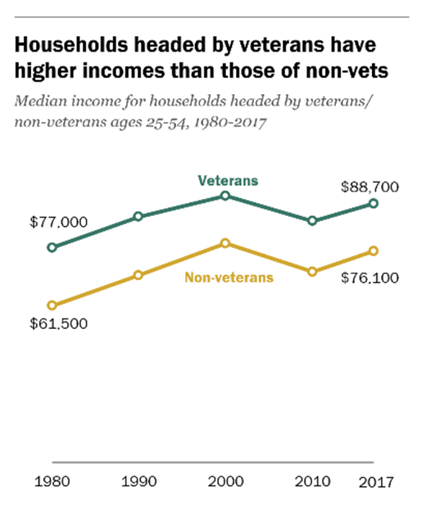


Veterans Outperform Their Non-Veteran Peers
“Veterans are 39% more likely to be promoted earlier than non-veterans.”
“Post 9/11 veterans earn more than those who never served in the Armed Forces”
Nov 2020
Pew Research Center, Dec 2019

Slide 8
Transition Assistance Program (TAP)
Via TAP last year, almost 500 VETS funded contractors prepared over
242,000 service members and military spouses for meaningful careers
VETS funded TAP Employment Curriculum served over 216,000 participants at over 200 military installations across the globe
The VETS funded Employment Navigator and Partnership Program (ENPP) served over 6,000 participants at over 45 military installations across the globe

Slide 9

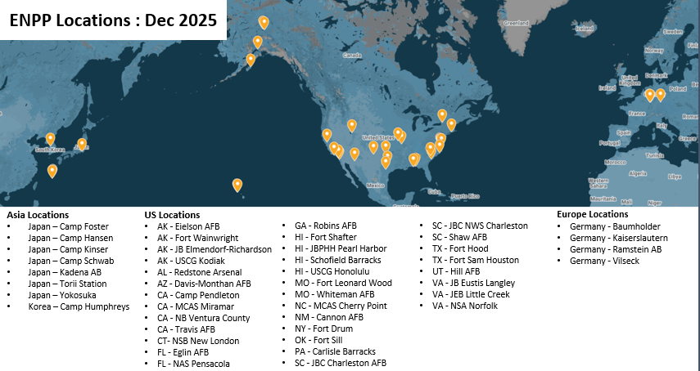
The ENPP served over 6,000 participants at 48 installations in FY 2025
Intent is to expand the ENPP to annually serve at least 30,000 participants by the end of FY 2030
PHASE I
OVER 90 EMPLOYMENT NAVIGATORS (ENs) PROVIDE THE FOLLOWING SERVICES:
Career Exploration
Self-assessments and Skills Testing
Review of Detailed Labor Market Information
Identification of Necessary Credentials
Apprenticeship Overview
Networking Activities
Employment Partner Overview and Connection
Resume Review
Interview Preparation
PHASE II
OVER 70 EMPLOYMENT PARTNERS PROVIDE SERVICES ACROSS 9 CATEGORIES:
Job Placement Services
Digital Matching
Referrals to Employment Opportunities
Apprenticeship
Training Services
Employment Mentorship
Employment Networking
Hiring Events
Wrap-around Services within Communities

Slide 10
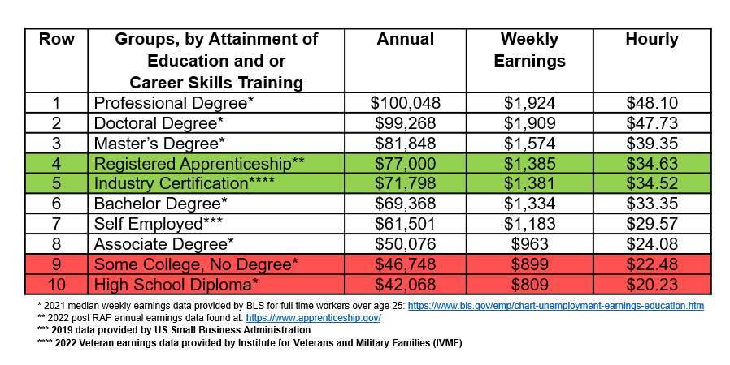

Wage Outcomes

Slide 11

Military Spouse Training and Support
TEAMS extends DOL TAP to military spouses and caregivers through virtual and classroom, stand-alone workshops and seminars.​
In addition to being available virtually in different time zones to fit busy schedules, TEAMS is available in-person at classrooms worldwide by request. Email Milspouse@dol.gov to get started.
​
Learn more and register at dol.gov/TEAMSWorkshops.
TEAMS Overall Performance Metrics
Fiscal Year | In-Person Workshops | In-Person Participants | Virtual Workshops | Virtual Participants
FY2021 | 6 | 22 | 91 | 480
FY2022 | 115 | 544 | 155 | 659
FY2023 | 256 | 1,523 | 142 | 552
Total | 377 | 2,089 | 388 | 1,691

Slide 12
MILITARY SPOUSES
“The Force Behind the Force”
Military Spouses are more highly educated than most working Americans
88% of Military Spouses have some post high school education; 34% have college degrees; 15% have a graduate degree
~16% Military Spouse unemployment rate
~35-40% Military Spouse underemployment
38% earn less than their civilian counterpart
Licensure transferability issues -- 35% work in field requiring a license
Enabling all veterans, transitioning service members and military spouses to reach their full potential in the workplace

Slide 13
Jobs for Veterans State Grants (JVSG)
JVSG is a formula grant to 54 State Workforce Agencies to hire dedicated staff who work in the American Job Centers to provide individualized career services to veterans and eligible persons, and to assist employers to fill their workforce needs with job-seeking veterans
Local Veterans Employment Representative (LVER) staff conduct outreach to employers to advocate for the hiring of all veterans
Disabled Veterans Outreach Program (DVOP) specialists provide individualized career services to eligible veterans and eligible spouses experiencing barriers to employment, as well as other additional populations authorized by the Secretary
Consolidated DVOP/LVER staff serve in a dual role as a DVOP specialist and an LVER
In Program Year (PY) 2023, JVSG funded 337 LVER staff, 841 DVOP specialists, and 135 Consolidated Positions
In Fiscal Year (FY) 2024, LVERs, through employer outreach, served 134,247 participants, and DVOPs served 41,532 veterans with significant barriers to employment (41,532 is a subset of 134,247 veteran participants)
In addition, veterans receive priority of service for all workforce training programs funded in whole or in part by DOL, as established by the Jobs for Veterans Act of 2002 (38 U.S.C. § 4215)

Slide 14
JVSG Participant Profile
Were discharged more than 9 years ago
Have more than one barrier to employment
Unemployed†
62%
73%
83%
± Average age at program enrollment *Also a qualifying employment barrier
**Separated from service three or fewer years ago †Unemployed at program entry or Unemployed for 27+ consecutive weeks
Non-Service-Connected Disabled: 5%
Data source: Program Year 2023 Quarter 4, ETA-9172, Participant Individual Record Layout (PIRL)
Notes:
The typical JVSG participant is a 47-year-old white male.
Over one-third (36%) of all participants are 55 or older.
Ethnicity: 11% Hispanic/Latino.
Sex: 82% male, 16% female, 1% not reported.
41% of participants have a college degree (29% bachelor’s or higher, 12% associate’s), and 33% have a high school diploma.
Employment barriers that qualify an eligible veteran/eligible person for DVOP services are defined Veterans’ Program Letter (VPL) 05-24. They are the seven items you see in the bar chart, “no high school diploma” found in the Education Level bar chart, plus single parent head of household, Vietnam-era veteran, and 18-24 years of age.
“Justice-involved” can mean currently or previously incarcerated.
57% of JVSG participants have a disability (23%) or special disability (34%) and 5% had a Non-Service-Connected Disability.

Slide 15
Homeless Veterans’ Reintegration Program (HVRP)
HVRP is the only federal grant to focus exclusively on competitive employment for veterans experiencing or at-risk of homelessness. HVRP programs are locally designed and tailored to the service area, helping America’s veterans experiencing homelessness reintegrate into the workforce
Each HVRP participant receives customized employment and training services to address their specific barriers to employment. Services may include occupational, classroom, and on-the-job training, as well as job search, placement assistance, and post-placement follow-up services
DVOP specialists and LVER staff may also support HVRP grantees by providing workforce system resources to help grant recipients achieve job placement and retention goals through case management, direct employer contact, job development, and follow-up services
HVRP is a competitive discretionary grant program. In Program Year (PY) 2024, HVRP awarded more than $61 million to 161 grantees, and served 15,888 veterans across the country. Participants had median second quarter after exit earnings of $8,710, and average hourly wages at job placement increased to $19.49, up from $19.44 the previous year
Each year, VETS uses a small portion of HVRP funds to support grantee Stand Down events. These events, held in local communities, provide a variety of social services to homeless veterans, and serve as gateways into structured housing and reintegration programs. In FY 2024, VETS awarded $294,611 for 40 Stand Down events in 18 states

Slide 16
Homeless Veterans’ Reintegration Program (HVRP)
Grants in Wisconsin
  Green Bay
  Eau Claire
  Madison
  Milwaukee
  Menomonie
70 of 72 Counties are Currently Served

Slide 17
HVRP Participant Profile
Were discharged more than 9 years ago
Have a disability
or special disability
Are
episodically homeless**
80%
34%
19%
± Average age at program enrollment *Duplicated count **An individual experiencing homelessness continuously for at least 12 months, or on at least four separate occasions in the last three years, where the combined occasions total at least 12 months
Data source: Program Year 2023 Quarter 4, Technical Performance Report (TPR)

Slide 18



Women Veterans
VETS Women Veteran Program conducts analysis of the employment situation of women Veterans and makes policy recommendations as appropriate. 12 month annual average unemployment rates comparing gender and veteran status are updated monthly and made available on the VETS Women Veteran Research webpage:
  https://www.dol.gov/agencies/vets/womenveterans
In 2021, there were 1,973,000 women veterans
  1 in 67 women is a veteran (compared to 1 in 7 men)
  1 in 9 veterans is a woman (1 in 6 GW II veterans is a woman)
Among all veterans, the median age of men is significantly older than that of women. Median Ages:
  All Women Veterans: 51
  All Male Veterans: 65
Per era of service, the age gap closes. Median Ages:
  WW II/Korean War/Vietnam eras - Women: 82; Men: 82
  Other service periods - Women: 61; Men: 64
  GW I era - Women: 52; Men: 52
  GW II era - Women: 37; Men: 39
Notes:
The mission of the DOL VETS Women Veteran Program is to make statistical analyses and other research easily accessible in order to inform policy decisions and the national narrative on women veterans. The VETS Women Veteran Research webpage serves as a repository of both statistical analysis conducted by the Women Veteran Program and links to applicable external research.
There are nearly 2 million women veterans and today 1 in 9 veterans is a woman. Women veterans are actually a smaller minority among women, with only 1 in 67 American women being a veteran.
Half of male veterans are aged 65 years or older, and the median age of all women veterans is 14 years younger than that of male veterans. This difference is largely due to the majority of veterans of the oldest eras being men. When we look at the median ages by service era, we see that the median age for women and men is the same for some eras, and only 2-3 years different in others.

Slide 19
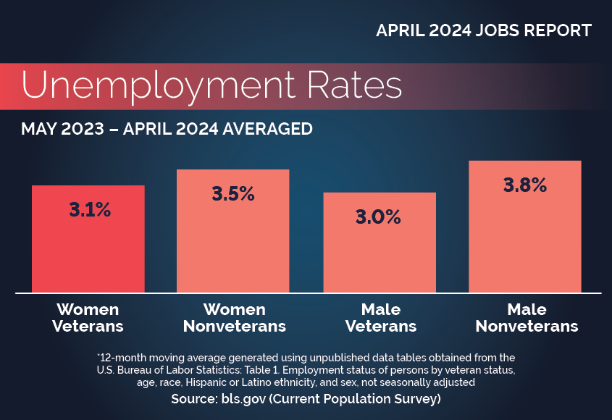
Women Veterans
Rolling annual averages are updated the first Friday of each month and made available on the VETS Women Veteran Research page: https://www.dol.gov/agencies/vets/womenveterans

Slide 20
Uniformed Services Employment and Reemployment Rights Act (USERRA)
USERRA prohibits discrimination in employment based on an individual’s prior service in the uniformed services, current service in the uniformed services, or intent to join the uniformed services
  Anti-discrimination: USERRA provides that employers cannot take any adverse action against any current or prospective employee, due in any part to that individual’s past, present, or future military service, status, or obligations;
  Anti-retaliation: USERRA provides that employers cannot take any adverse action against any employee—regardless of any military affiliation—for either asserting or helping another employee assert their rights under the statute; and
  Reemployment: USERRA provides that employees who meet the criteria for entitlement to reemployment rights must be promptly reinstated into the same or similar positions of seniority, status, and rate of pay they otherwise would have attained had they remained continuously employed. This is commonly referred to as the escalator principle and has been the law since 1946
Of the 1,200 complaints investigated during FY 2023, VETS closed 1,022 cases. Of cases in which DOL VETS found a violation of USERRA, DOL VETS resolved 93%. On average, cases were closed in 68 days
In addition, the Veterans’ Employment Opportunity Act (VEOA) Administration and Enforcement VEOA primarily protects veterans’ preference in Federal hiring and during Reductions in Force (RIFs). The U.S. Office of Personnel Management (OPM) is responsible for interpreting and administering those statutes and regulations governing veterans’ preference in the federal sector. VETS is responsible for investigating complaints received from preference-eligible veterans who believe their veterans’ preference rights in federal hiring or during RIFs were violated. VETS receives 600-800 veterans’ preference complaints annually

Slide 21

Protecting Employment Rights
Uniformed Services Employment and Reemployment Rights Act (USERRA); 38 U.S.C. 4301-4335
VETS administers and enforces USERRA with the support of ESGR, DOJ, and OSC.
USERRA protects employment rights for veterans, active-duty members, and members of the reserve components.
Most cases are resolved without the need for enforcement.
Claimants can refer cases to DOJ or OSC.
DOJ and OSC satisfactorily resolve most substantiated referred cases.
Veterans’ Preference in Federal Hiring; 5 U.S.C. 3330a
VETS investigates claims of violation of veterans’ preference rights in Federal hiring.

Slide 22
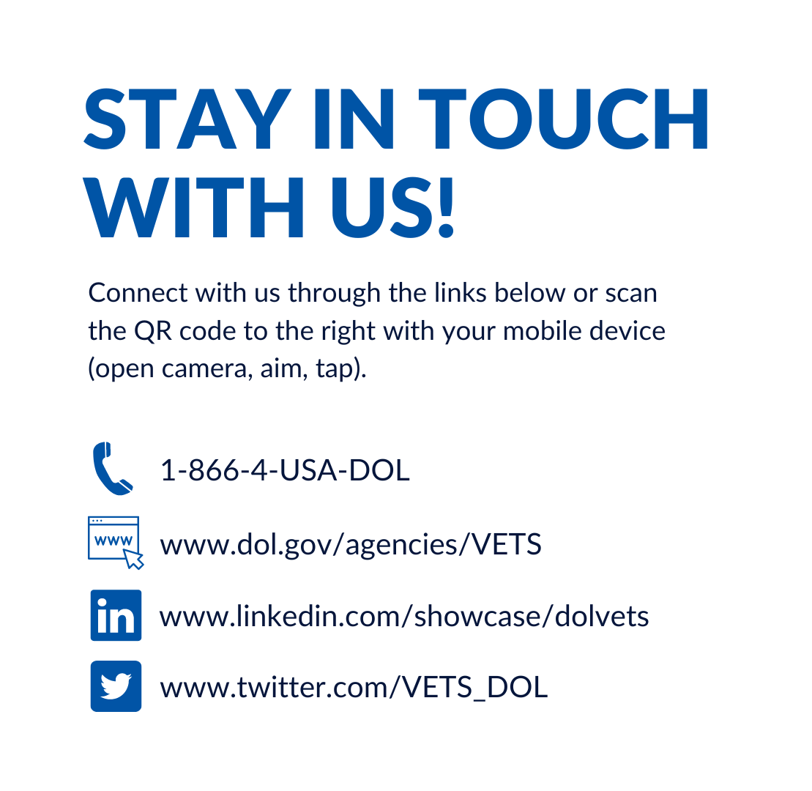
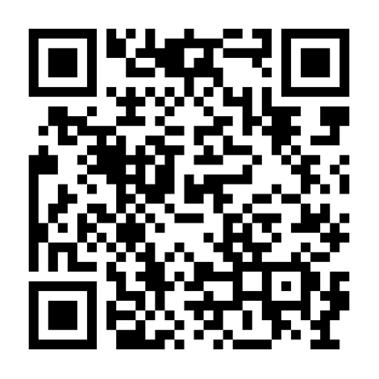

Slide 23
23

Slide 24
Contacts
Phil Koenig
  Director, Wisconsin Office
    Veterans Employment And Training Services
      koenig.philip.c@dol.gov
        (202) 306-6529
Jessica Maple
  Assistant Director, Wisconsin Office
    Veterans Employment And Training Services
      maple.Jessica.r@dol.gov
        (715) 348-6864

