Slide 1




Spring Conference Ctvso Training Presents: Secondary Conditions
Buffalo County Veteran Service Officer: Felicia M. Decker
608-685-6219
felicia.decker@buffalocountywi.gov

Slide 2

Acts
I
II
III
The Mission Foundation
The Body Break Down
Secondary Conditions
The Tools in the tools Box
Obesity :is not a primary it is a pathway to secondary
Common Primary Conditions/Diseases
Diabetes Mellites II:
Back Conditions
Cardiovascular conditions
Joints/ Pain / Arthritis
Respiratory Conditions
Closing Statements: Listen
Brief You tube Video: old Glory
Questions?
The END

Slide 3
Act I

Slide 4

County /Tribal Veteran Service Office Mission
In Wisconsin, the County /Tribal Veterans Service Officer plays a critical role in the veteran's advocacy system and is often the initial contact in the community for veteran’s services. Through the County Veterans Service Office, we provide a vital and efficient system of services and advocacy to veterans, their dependents, and survivors. we promotes legislation and policy at both the state and federal levels that is supportive of veterans’ rights and issues that are in harmony with our national obligation to veterans of the United States armed forces. It is the intent of this Department that every veteran residing in a County/Tribe receives the benefits and services to which they are entitled by law and moral obligation.

Slide 5

How Can we help you?
We Assist in Putting Claims Together From Medical Records, Timelines and processes needed for successful claims
We Can Assist you in getting enrolled in the Health Benefit ( VA Form 10-10EZ)
We Assist with State Benefits and Federal benefits

Slide 6
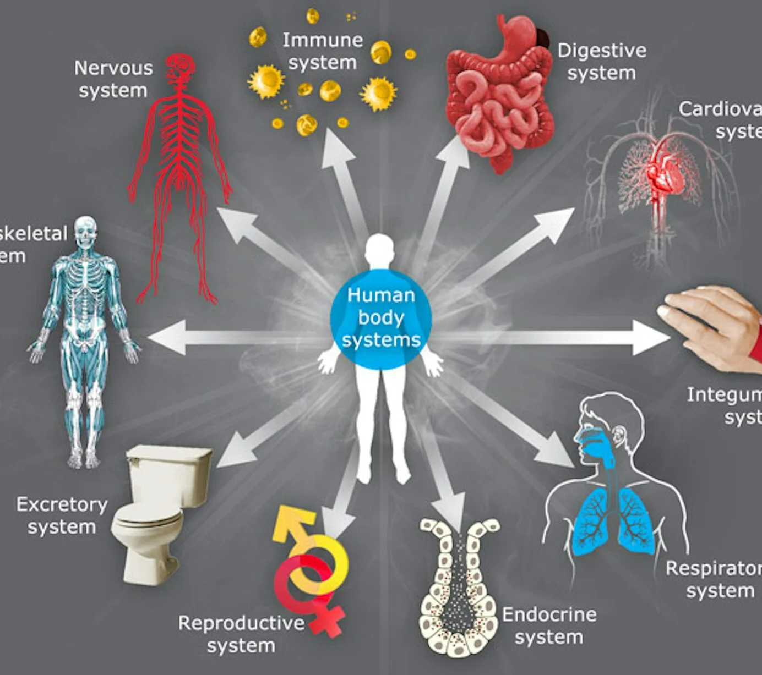
The Body
The Mind

Slide 7
The VA Has 15 Systems of the body
Musculoskeletal System: This includes conditions related to bones, joints, and muscles, such as arthritis and back pain. It is crucial for movement and support.
Respiratory System: Covers conditions affecting breathing, such as asthma and chronic obstructive pulmonary disease (COPD).
Cardiovascular System: Encompasses heart-related conditions, including hypertension and ischemic heart disease.
Digestive System: Includes disorders affecting the stomach and intestines, such as gastroesophageal reflux disease (GERD) and irritable bowel syndrome (IBS).
Genitourinary System: Covers conditions related to the urinary tract and reproductive organs.
Endocrine System: Involves hormonal disorders, including diabetes and thyroid conditions.
Nervous System: Encompasses neurological conditions, such as multiple sclerosis and Parkinson's disease.

Slide 8
The VA Has 15 Systems of the body
Mental Disorders: This includes a range of psychological conditions, with post-traumatic stress disorder (PTSD) being one of the most common.
Skin: Covers various skin conditions, including dermatitis and psoriasis.
Hemic and Lymphatic System: Involves blood disorders and conditions affecting the lymphatic system.
Special Senses: This includes vision and hearing impairments, such as cataracts and hearing loss.
Infectious Diseases: Covers conditions caused by infections, including tuberculosis and HIV/AIDS.
Immune Disorders: Involves conditions that affect the immune system, such as lupus and rheumatoid arthritis.
Dental and Oral Conditions: Covers issues related to dental health and oral diseases.
Miscellaneous: This category includes other conditions that do not fit neatly into the above systems but still require evaluation

Slide 9
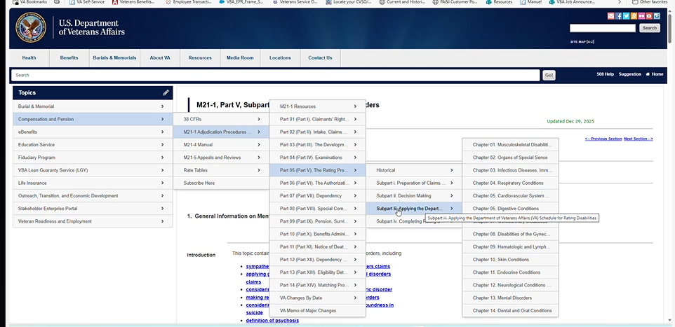

Slide 10
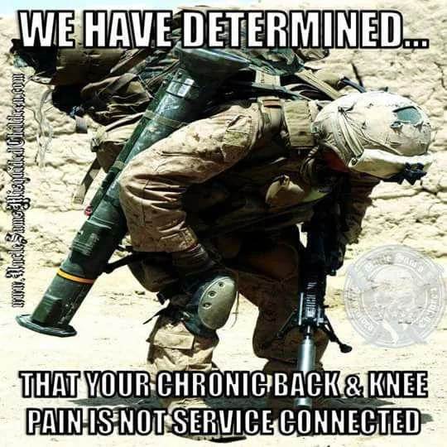

Slide 11
Secondary Conditions: What IS This?
new physical or mental health conditions that develop as a direct result, complication, or aggravation of an existing primary disability
38 CFR § 3.310 (a)(B)governs VA disability for conditions that are proximately due to, or aggravated by, a service-connected disease or injury
Case Law :Timing of Diagnosis /Connection Frost VS Shulkin, Proximate cause/robinette VS. Brown ETC
M21 V.II2.D.1 Aggravation Based on Secondary Conditions

Slide 12
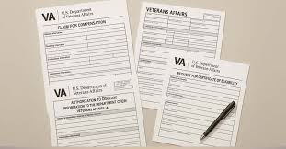
Secondary Conditions: How Do you File?
VA FormS :
21-22 POA
INT 21-0966 place holder
21-526EZ – Initial Claim Form/ Secondary
21-4142 21-4142a- Release of Medical Information
21-4138- Statement In support of Claim
Medical Records/Nexus Letter

Slide 13

Secondary Conditions: When Do you File?
Immediately Upon Diagnosis: When a doctor links a new condition to your current service-connected disability
When Service connection Worsens: If an existing service-connected condition causes a new, separate issue (e.g., a back injury leading to radiculopathy or altered gait causing knee pain)
As New Evidence Emerges: Secondary conditions often appear years later; there is no time limit to file once they develop
Medication Side Effects: If treatments for your primary disability cause new conditions (e.g., medication-induced high blood pressure or GERD)

Slide 14

Case By Case
Set Goals to manage Veterans expectations
Observe what they can handle and what would be too much at one time.
Ask the Questions with the systems of the body
Know Your Military Branches and Assigned Duties

Slide 15

Get it all
There are times when you Just have one Opportunity to go through an intake with a veteran
Ask the Questions Internal/ external.
Leave None Behind

Slide 16

What tools are in your Toolbox?

Slide 17

Think Outside the Box
Credible Medical Studies resources:
Nexus letters From Treating Physicians
Lay/ Witness statement
M21, CFR, Case Law
Osha / Environmental Reports
Medications and their side effects

Slide 18
Think Outside the Box
M21-Part IV, I,Chapter 3 Sec A General criteria for sufficiency of C&P examination reports
State Licensure:
Medical Specialty relevance
Physician Supervision
Training in VA Evaluation Procedures
Competency to Diagnose(38 U.S.C 5103A(d)
Independent review
* Note: For sufficiency General Practitioner VS Specialist / Impact of improper credentials

Slide 19
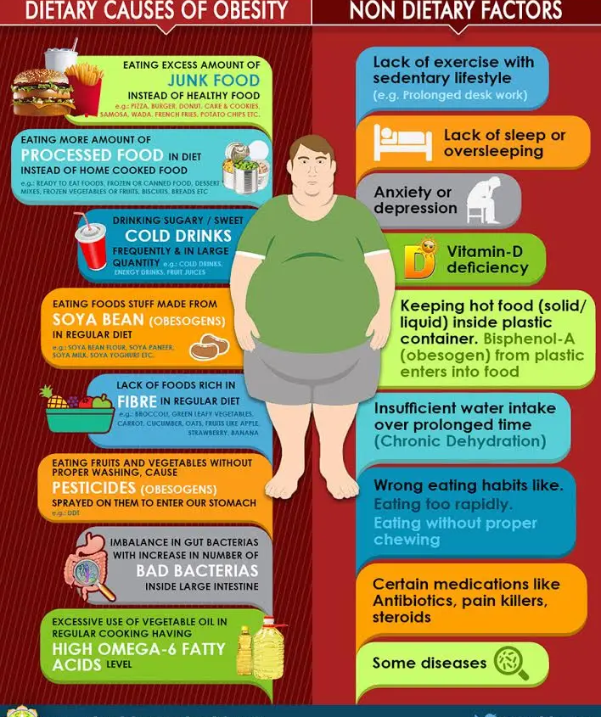
Obesity A steppingstone to secondary conditions Case#1
What are the primary Conditions?
Cause and Effect
M21-1 V.ii.3.C.3.b./ Sources

Slide 20
Obesity: A steppingstone to secondary conditions
Primary Behavioral and Environmental Drivers
Biological and Physiological Factors
Energy Imbalance: Consuming more calories (particularly processed, sugary foods) than are expended through daily activities.
Lack of Physical Activity: Modern, sedentary lifestyles and reduced manual labor limit calorie burning.
Dietary Patterns: High-calorie fast food, sugar-sweetened beverages, and lack of fiber.
Environmental Factors: Unhealthy food availability, high-calorie food advertising, and lack of safe spaces for exercise
Genetics: Genetic makeup can influence hunger levels, metabolism, and fat distribution.
Hormonal Imbalance: Disruption in appetite-regulating hormones (ghrelin and leptin) can lead to increased hunger and lower satiety.
Metabolic Factors: Some individuals have lower energy expenditure, making weight gain easier.

Slide 21
Obesity A steppingstone to secondary conditions
Lifestyle and Other Contributing factors
Sources:
Sleep Deprivation: Lack of sleep alters hormones that control appetite, leading to increased hunger.
Stress: Chronic stress increases cortisol levels, which promotes belly fat storage and cravings.
Medications: Certain antidepressants, corticosteroids, and anti-seizure drugs can cause weight gain.
Health Conditions: Underlying conditions like Cushing's syndrome or hypothyroidism.
Psychological Factors: Emotional eating or depression
MAYO Clinic:
https://www.mayoclinic.org/diseases-conditions/obesity/symptoms-causes/syc-20375742
National Library Of Medicine:
https://pmc.ncbi.nlm.nih.gov/articles/PMC6530037/
National Heart, Lung and Blood Institute:
https://www.nhlbi.nih.gov/health/overweight-and-obesity/causes.
(CDC )Center For Disease Control:
https://www.cdc.gov/obesity/risk-factors/risk-factors.html

Slide 22
ACT II

Slide 23
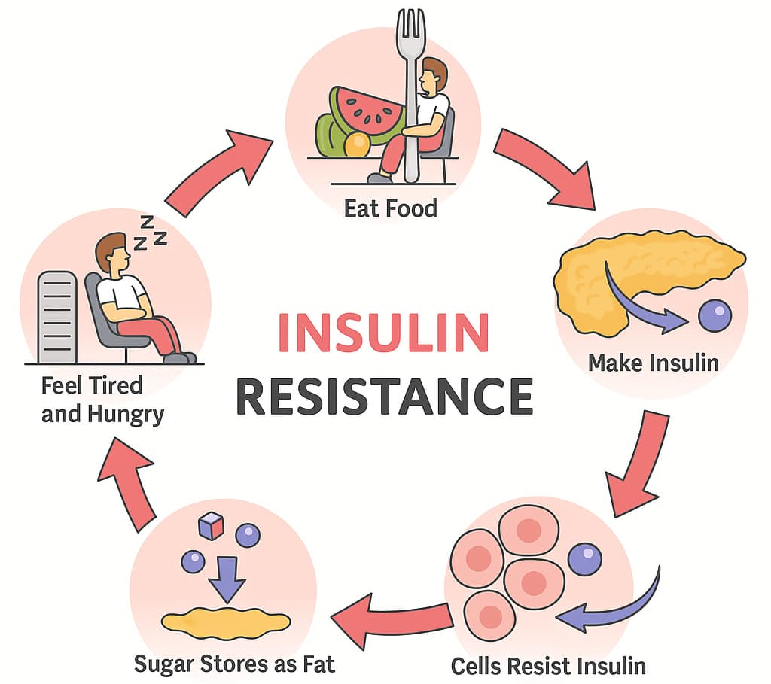
Diabetes Mellites Type I&II
Case #2

Slide 24
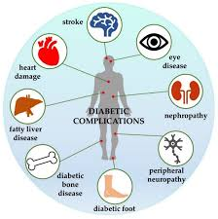
Common Secondary Conditions of Type II Diabetes
Diabetic Neurapathy: Nerve damage, including peripheral neuropathy (numbness/tingling in hands/feet) and autonomic neuropathy (affects digestion and bladder function)
Kidney Disease (Diabetic Nephropathy):damage to Kidneys, which can lead to Kidney Failure
eye Problems (Retinopathy): Diabetic retinopathy, cataracts, glaucoma, and macular edema.

Slide 25
Common Secondary Conditions of Type II Diabetes
Skin Infections Issues: Diabetic dermopathy, necrobiosis lipoidica diabeticorum, and increased susceptibility to fungal or bacterial infections.
Mental Health : Depression is commonly linked to managing the daily strain of diabetes.
Other related Conditions: Erectile dysfunction (ED), Gastroparesis, and peripheral vascular disease leading to amputations

Slide 26
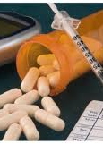
Medications:
Secondary conditions can also arise from side effects of medications used to manage Type II diabetes:
GLP-1 Agonists: May cause gastrointestinal issues like nausea, vomiting, constipation, or reflux.
SGLT2 Inhibitors: Linked to increased urination, thirst, urinary tract infections, and yeast infections.
Metformin: Commonly causes gastrointestinal upsets.
Insulin: Main risk is hypoglycemia (low blood sugar).
Thiazolidinediones (e.g., Avandia, Actos): May increase risk for heart failure

Slide 27
Key Resources: CFR, M21, Case Law
diabetes mellitus (Type 1 or Type 2) are
38 CFR § 4.119, Diagnostic Code 7913
M21-1, Part V, Subpart iii, Chapter 11 - Endocrine Conditions
Case Law Searches?:
https://www.uscourts.cavc.gov
Secondary Service Connection: Cases often explore whether diabetes is proximately due to or aggravated by a service-connected disability, such as a lumbar spine condition causing inactivity or mental health issues leading to medication-induced obesity
Obesity as an Intermediate Step: Recent Board decisions have recognized that if a service-connected condition causes a veteran to gain weight (obesity), and this obesity leads to Type II diabetes, the diabetes may be considered secondary to the original service-connected condition

Slide 28
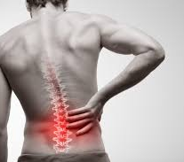
Back Conditions
Case#3

Slide 29
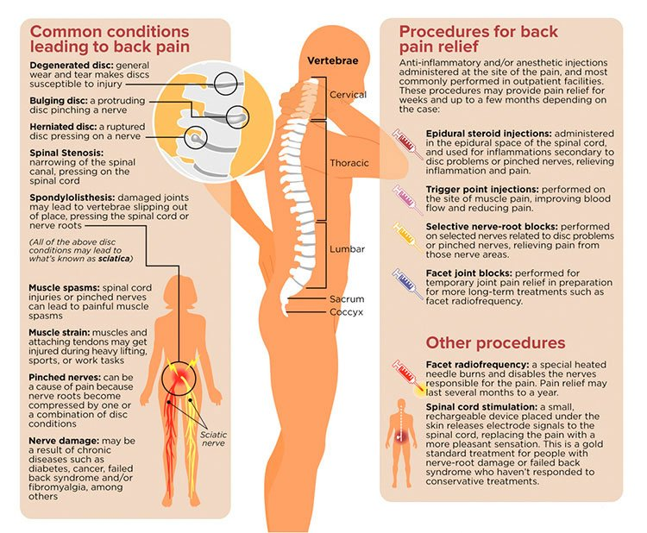

Slide 30
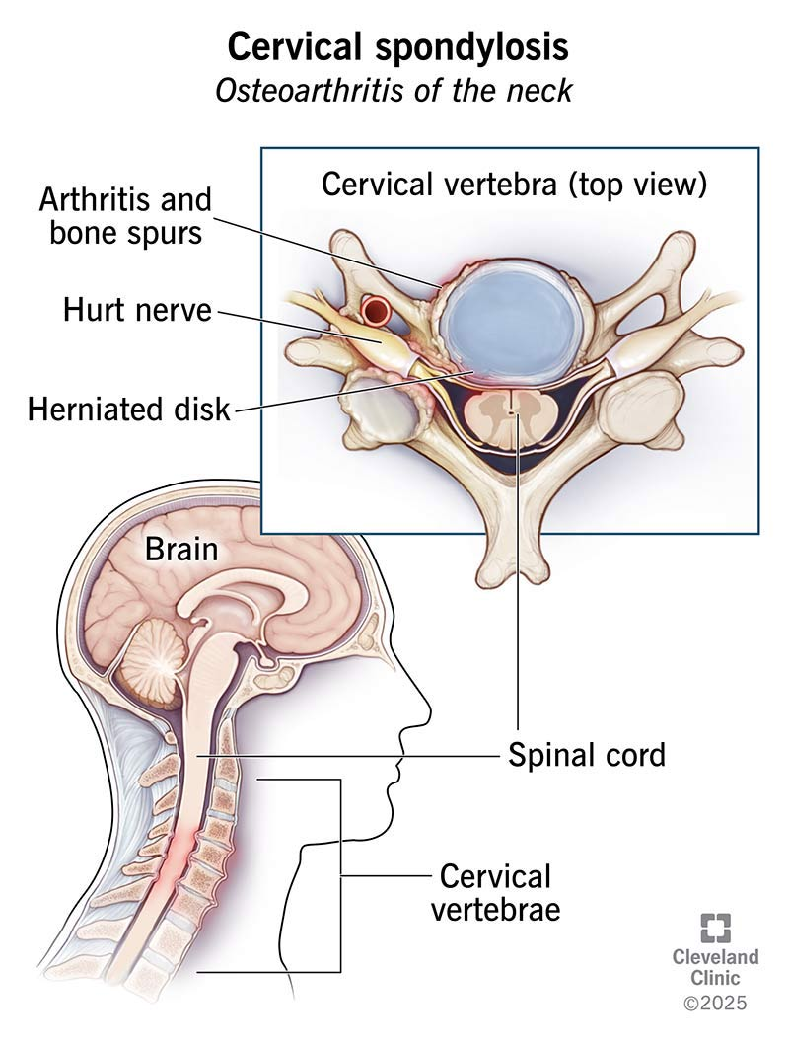
UppEr: Cervical
Common Secondary Conditions to Cervical Spine Issues:
Cervical Radiculopathy: Pinched nerves causing pain, numbness, or tingling in the shoulders, arms, hands, and fingers.
Chronic Headaches/Migraines: Muscle tension and nerve irritation resulting from neck strain.
Cervical Myelopathy: Severe compression of the spinal cord in the neck, potentially leading to balance issues and hand dysfunction.
Thoracic Outlet Syndrome: Compression of nerves or blood vessels at the top of the ribs, causing arm pain or numbness.
TMJ (Temporomandibular Joint) Dysfunction: Altered jaw mechanics resulting from chronic neck tension

Slide 31
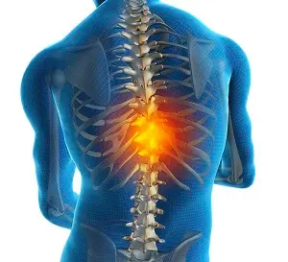
UppEr: Thoracic
Thoracic Radiculopathy: Pinched nerves in the mid-back causing pain that wraps around the chest or torso.
Degenerative Disc Disease: Accelerated wear and tear in the thoracic spine, often caused by compensation for cervical or lumbar issues.
Respiratory Issues: Reduced lung capacity or breathing difficulty due to rigidity or pain in the thoracic cage.
Postural Changes/Kyphosis: Increased thoracic curvature leading to pain, decreased mobility, and cosmetic changes

Slide 32
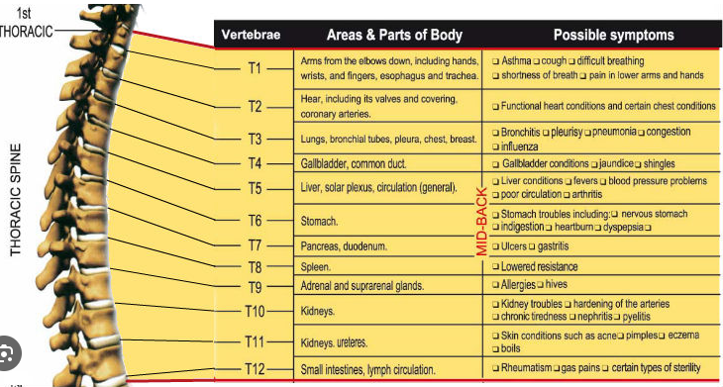

Slide 33
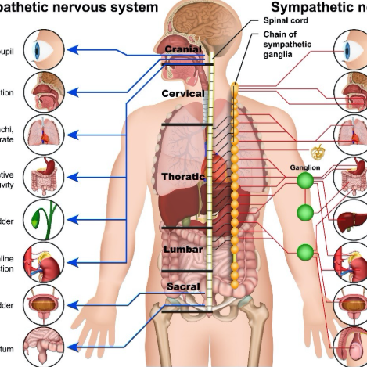
Systematic Secondary Conditions Combined
Chronic Pain Syndrome & Mental Health: Ongoing pain can cause depression, anxiety, and sleep apnea.
Fibromyalgia: Widespread musculoskeletal pain often triggered by chronic spinal issues.
Secondary Muscle Weakness: Loss of grip strength or reduced mobility in arms/torso

Slide 34
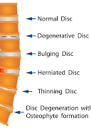
Lower: Lumbar
Radiculopathy (Nerve Damage): Pinched nerves from herniated discs can cause numbness, tingling, or pain in the legs, hips, and feet.
Joint and Musculoskeletal Issues: Altered movement patterns (gait) often cause arthritis in the hips or knees, as well as plantar fasciitis.
Mental Health Disorders: Chronic pain frequently leads to depression and anxiety.
Sleep Disorders: Persistent discomfort can cause or exacerbate insomnia.
Sexual Dysfunction: Back issues may cause or worsen erectile dysfunction in men or sexual arousal disorders in women.
Gastrointestinal Issues: Chronic pain medications can lead to secondary gastrointestinal problems.

Slide 35
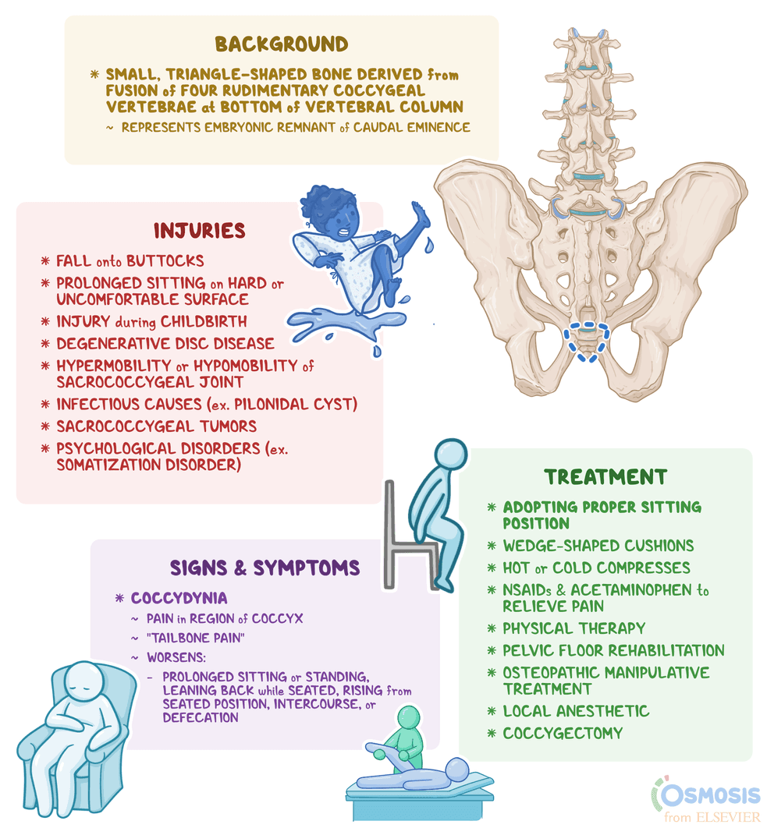
Lower: Sacrum/Coccyx
Radiculopathy (Sciatica): Pinched nerves in the lower spine can cause radiating pain, numbness, tingling, or weakness in the buttocks and legs
Sacroiliac (SI) Joint Dysfunction: Pain, stiffness, or instability in the joints connecting the sacrum to the pelvis
Coccydynia (Chronic Coccyx Pain): Persistent pain in the tailbone, often caused by dislocation or injury
Musculoskeletal Changes: Muscle tension and spasms in the pelvic floor, hips, and lower back, often leading to restricted mobility

Slide 36
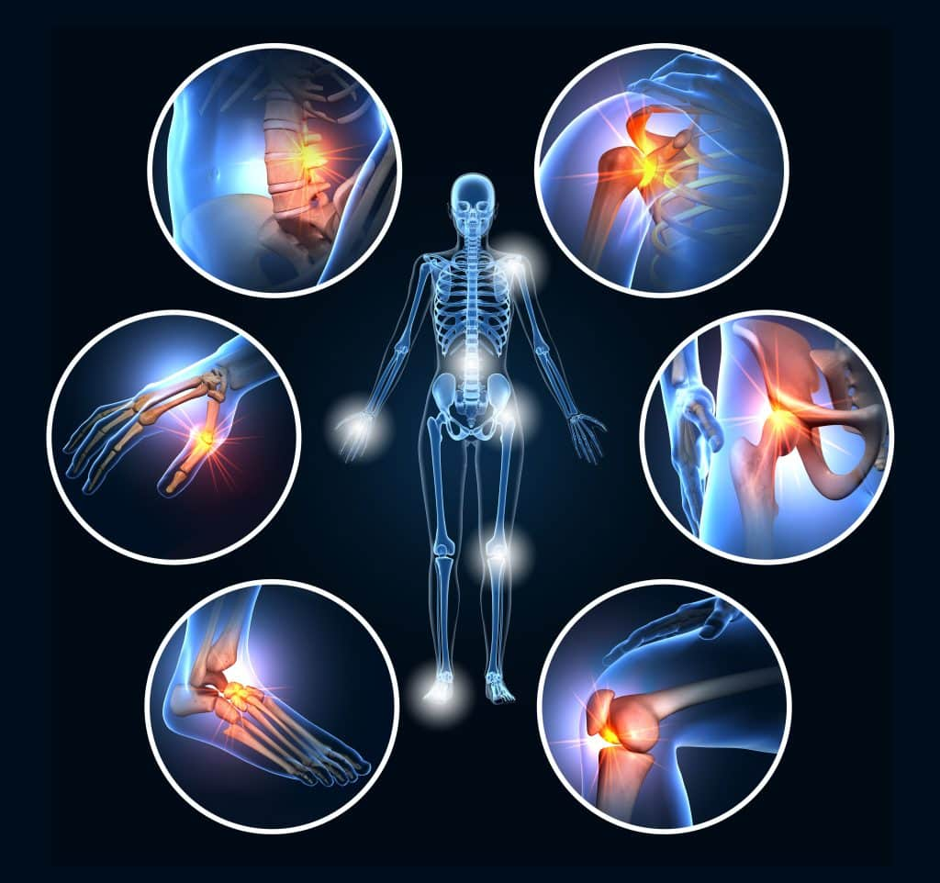
Lower: Sacrum/Coccyx CONT….
Lower Extremity Complications: Hip pain, knee pain, or plantar fasciitis
Functional Limitations: Difficulty walking, standing, or sitting for extended periods
Systemic/Psychological Impacts: Sleep disorders, depression, anxiety, and in rare cases, bladder/bowel incontinence related to spinal dysfunction

Slide 37

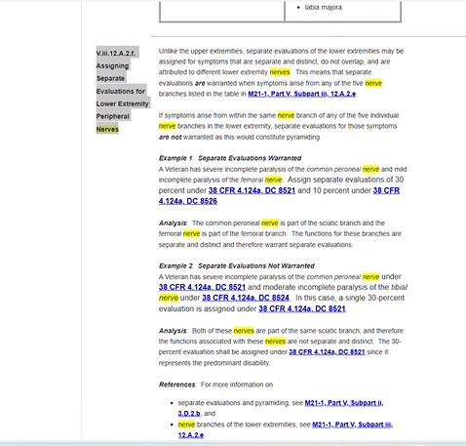

Slide 38
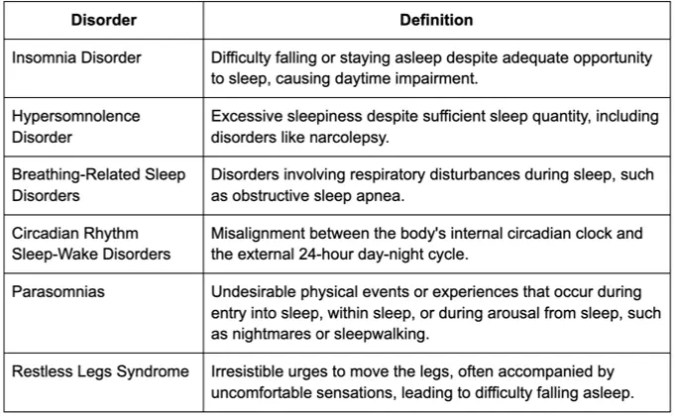
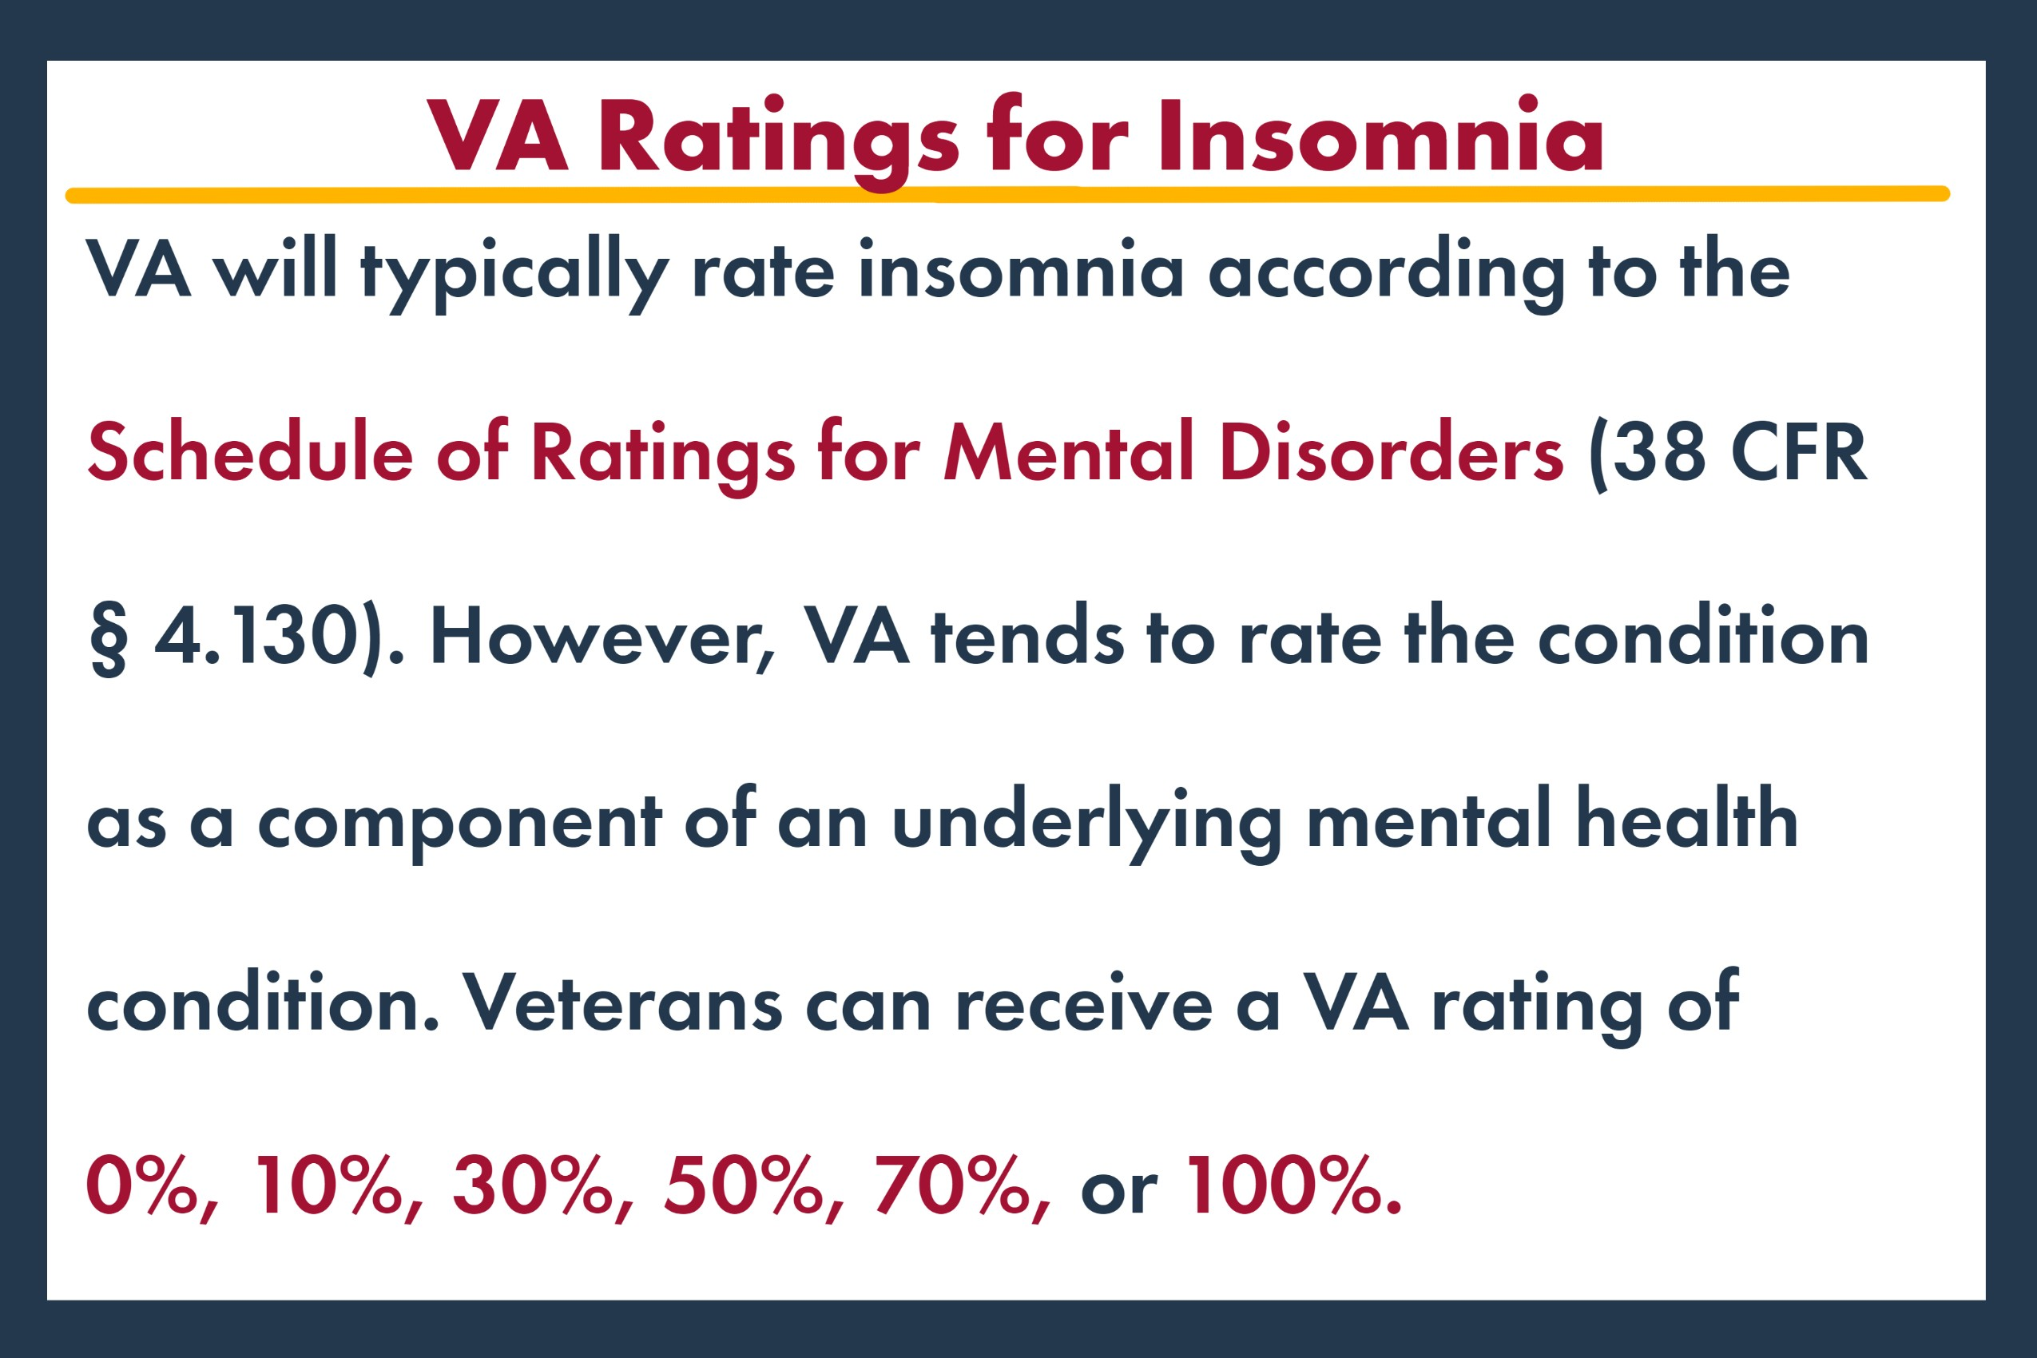

Slide 39
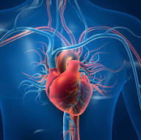
Cardiovascular issues
Case#4

Slide 40
What are The Primary Cardiovascular Conditions Leading to Secondary?
Hypertension (High Blood Pressure): Leads to heart disease, strokes, and renal damage.
PTSD/Chronic Stress: Elevated cortisol and chronic stress can damage the cardiovascular system over time.
Diabetes: Increases risk of stroke, heart attack, and coronary artery disease.
Sleep Apnea: Causes repeated oxygen deprivation, putting massive strain on the heart

Slide 41

Common Secondary For Cardiovascular Conditions
Kidney Disease: The heart and kidneys work closely; cardiovascular disease can cause high blood pressure, leading to kidney strain or failure
Stroke or TIA (Transient Ischemic Attack): Poor circulation, blood clots, or high blood pressure can cause vascular blockages in the brain
Peripheral Vascular Disease (PVD) / Peripheral Arterial Disease (PAD): Arteries narrowing, affecting limbs

Slide 42
Secondary Cardiovascular Conditions
Mental Health Disorders: Chronic cardiovascular diseases frequently cause depression, anxiety, or high stress.
Erectile Dysfunction (ED): Damage to blood vessels restricts blood flow to reproductive organs.
Heart Failure/Atrial Fibrillation: Weakened heart muscles can lead to secondary cardiac conditions

Slide 43

Medications
Cholesterol-Lowering Drugs (Statins): Atorvastatin (Lipitor), Rosuvastatin (Crestor), Simvastatin (Zocor), Ezetimibe.
Beta-Blockers: Metoprolol (Lopressor), Carvedilol (Coreg), Atenolol (Tenormin).
ACE Inhibitors/ARBs: Lisinopril (Prinivil), Enalapril (Vasotec), Losartan (Cozaar).
Diuretics (Water Pills): Furosemide (Lasix), Hydrochlorothiazide (HCTZ), Spironolactone (Aldactone).
Anticoagulants/Antiplatelets (Blood Thinners): Aspirin, Clopidogrel (Plavix), Rivaroxaban (Xarelto).
Calcium Channel Blockers: Amlodipine (Norvasc), Diltiazem (Cardizem), Verapamil.
Heart Failure Medications: Digoxin (Lanoxin), Ivabradine (Corlanor)

Slide 44
Key Resources: CFR, M21, Case Law
38 CFR § 4.104 (Diagnostic Codes 7000–7123) based on METs (Metabolic Equivalents) testing, measuring functional capacity. Ratings of 10%, 30%, 60%, or 100% are assigned based on severity of heart failure symptoms (dyspnea, fatigue, angina, dizziness) during exertion, with 100% often representing incapacity.
M21-1, Part V, Subpart iii, Chapter 5 - Cardiovascular System Conditions
applying the benefit-of-the-doubt rule (38 U.S.C. § 5107) when evidence is in equipoise
Heart Disease Secondary to PTSD: Wise v. Shinseki
Atrial Fibrillation Secondary to CAD: Frost v. Shulkin
Benefit of the Doubt :Gilbert v. Derwinski )

Slide 45
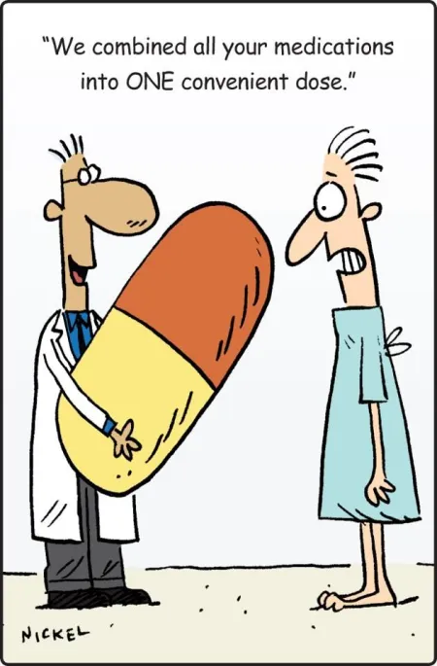
Joints, Pain , and Arthritis
Case # 5
Oh My!!!!!

Slide 46

Joints: Pain/Arthritis
Case Law: Saunders VS. Wilkie
38 USC 1110 Basic Entitlement: For disability resulting from personal Injury suffered or disease contracted in line of duty, or for aggravation of a preexisting injury suffered in line of duty, in active military, naval , or air service during a period of war, the united states will pay to any veteran this disabled and who was discharged or released under conditions other than Dishonorable from the period of service in which said injury or disease was incurred ,or Preexisting injury or disease was aggravated , compensation as provided in this sub chapter , but no compensation shall be paid if the disability is a result o the Veterans own willful misconduct or abuse of alcohol or drugs.

Slide 47
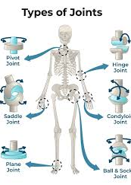
Joints: Facts
Definition of Major Joints: The shoulder, elbow, wrist, hip, knee, and ankle are considered major joints for evaluating arthritis
Military members commonly suffer from joint injuries due to high-intensity training, heavy rucking, and combat, with knees, ankles, shoulders, and the lower back being most affected. Over 95% of injuries are musculoskeletal, often stemming from overuse (microtrauma), leading to conditions like sprains, tears (ACL/meniscus), and post-traumatic arthritis.
https://pmc.ncbi.nlm.nih.gov/articles/PMC3867090/#:~:text=Jones%20et%20al3%20reported,positions%2C%20and%20prolonged%20static%20positioning.

Slide 48
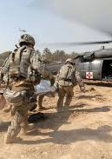
Joints: Facts
These injuries are the leading cause of medical evacuation from combat zones and top causes for medical separation from service. They often lead to a high rate of post-traumatic osteoarthritis
https://ph.health.mil/topics/discond/ptsaip/Pages/Army-Injuries-Causes-Risk-Factors-and-Prevention-Overview.aspx#:~:text=What%20are%20the%20most%20common,compared%20to%20non%2Dparatroopers).

Slide 49
Common Injuries To Joints
Commonly Injured Joints
Leading Causes and Context
Knee (Most Common): Overuse injuries, ligament tears (ACL), and meniscus damage are frequent, particularly during running and marching.
Ankle/Foot: Ankle sprains, fractures, and plantar fasciitis are common from running and physical training.
Shoulder: Dislocations and overuse injuries occur frequently, often related to training and lifting, with higher rates seen in specialized units.
Lumbar Spine (Lower Back): Chronic injury caused by lifting, carrying heavy gear, and repetitive strain.
Hip/Pelvis: Often affected by repetitive strain and high-impact training
Overuse/Overload: Over two-thirds of injuries result from cumulative, repetitive strain on joints during training.
Acute Trauma: Common in combat, including explosions which cause severe blast-related joint damage.
Non-Combat Activities: The vast majority of injuries (over 75%) occur during physical training, sports, and daily activities rather than combat

Slide 50
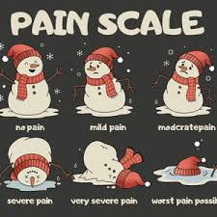
PAIN
Chronic Pain means Pain Lasting Longer than 6 Months
Chronic Pain “Disproportionally Affects” soldiers who are currently serving in the military or are Veterans of the Iraq and Afghanistan Wars

Slide 51
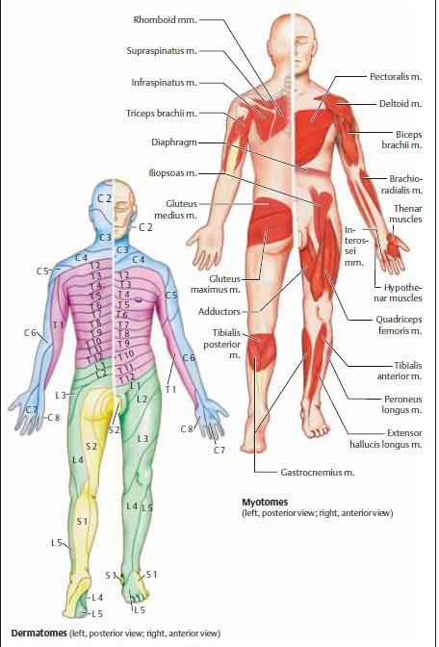
Dermatomes and Myotomes
Dermatomes are skin areas served by single spinal nerves, while myotomes are muscle groups innervated by them, mapped to diagnose neurological damage. ( Very important for secondary Conditions)

Slide 52
Arthritis: While there is often no cure, early diagnosis and treatment can improve mobility and prevent further joint damage, allowing many to manage symptoms effectively
Common Causes and Types
Treatment Options
Osteoarthritis (OA): Degenerative, "wear-and-tear" breakdown of joint cartilage, common in older adults.
Rheumatoid Arthritis (RA): Autoimmune disorder where the immune system attacks joints.
Gout: Metabolic arthritis caused by uric acid buildup.
Psoriatic Arthritis: Inflammatory arthritis linked to psoriasis.
Medications: Over-the-counter NSAIDs (ibuprofen, naproxen) or acetaminophen.
Lifestyle: Regular, low-impact exercise (walking, swimming) and maintaining a healthy weight.
Self-Care: Applying heating pads or ice packs to reduce swelling and pain.
Medical Care: Physical therapy, assistive devices (canes), or, for some, surgery

Slide 53
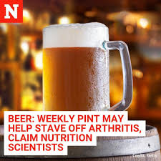
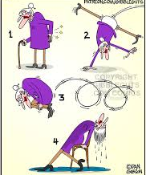
Medications:
Over the Counter(OTC):
NSAIDs (Nonsteroidal Anti-inflammatory Drugs): Reduce pain and swelling. Examples include Ibuprofen (Advil, Motrin IB) and Naproxen (Aleve)
Acetaminophen (Tylenol): Relieves pain but does not reduce inflammation
Topical Agents: Creams, gels, or patches containing diclofenac (Voltaren), menthol, or capsaicin provide targeted relief, especially for knee or hand arthritis
Combination Therapy: Using both anti-inflammatory medications and acetaminophen can be more effective than either alone
*Note : Side Effects: Oral NSAIDs can cause stomach issues, heart issues, and kidney damage with long-term use

Slide 54

Medications:
Prescription Medication Options:
Corticosteroids: These reduce inflammation and pain, such as prednisone, or can be injected into the joint.
Disease-Modifying Antirheumatic Drugs (DMARDs): Used for rheumatoid arthritis to slow disease progression and prevent joint damage.
Biologics: Targeted therapies (e.g., adalimumab, etanercept) for autoimmune arthritis.
JAK Inhibitors: A type of targeted DMARD for RA or psoriatic arthritis
Weak Opioids/Anticonvulsants: Tramadol or gabapentin may be used for severe chronic pain

Slide 55
Key Resources: 38 CFR, M21,Case law
38 CFR § 4.71a, Diagnostic Code 5003 (Degenerative Arthritis): The primary code for arthritis, it requires X-ray evidence of arthritis. Ratings are based on limitation of motion
38 CFR § 4.71a, DC 5002 (Rheumatoid Arthritis): Evaluates multi-joint arthritis based on the number of incapacitating episodes per year
38 CFR § 4.59 (Painful Motion): Establishes that painful motion is a key factor of disability. The VA must note wincing or pain during examination
38 CFR § 4.40 & 4.45 (Functional Loss): Directs that ratings must consider pain, weakness, fatigability, and incoordination (functional loss), even if not strictly limited in range of motion
* Note :Veterans are encouraged to note pain during exams, as painful motion is a legal basis for compensation. For a detailed breakdown of all criteria, review the 38 CFR § 4.71a Schedule of Ratings.
M21-1 Adjudication Procedures Manual Highlights( M21-1, Part V, Subpart ii, Chapter 2 Section A -
Minimum Rating for Pain: If a joint has arthritis, but the limitation of motion is not compensable (0%), a 10% rating is assigned if there is satisfactory evidence of painful motion
X-ray Requirement: Degenerative arthritis requires X-ray confirmation of joint involvement to be service-connected
Active vs. Residual Arthritis: Ratings for the active arthritis process (e.g., swelling, constant pain) are not combined with residual ratings (e.g., permanent limitation of motion) for the same joint; the higher of the two is assigned

Slide 56
Key Regulations: 38 CFR, M21,Case law
Case Law:
DeLuca v. Brown, 8 Vet. App. 202 (1995): The cornerstone case for arthritis and joint claims. It mandates that the VA consider the "functional loss" caused by pain during "flare-ups" or increased pain during repetitive use, beyond just the range of motion testing
Shedden v. Principi, 381 F. 3d 1163 (Fed. Cir. 2004): Established that a veteran must show a present disability, in-service incurrence/aggravation, and a nexus (causal link) to establish service connection.
Presumption of Chronicity: Arthritis is considered a chronic disease. If it manifests to a compensable degree (10% or more) within one year of separation, it can be presumed service-connected under 38 CFR 3.309(a)
Arthritis Rating Criteria:
20% Rating: X-ray evidence of involvement of 2 or more major joints or 2 or more minor joint groups, with occasional incapacitating exacerbations.
10% Rating: X-ray evidence of involvement of 2 or more major joints or 2 or more minor joint groups, OR 10% for a single joint with documented painful motion.
100% Rating (Rheumatoid): Total incapacitation (Rheumatoid Arthritis only)
*Note: Major joints include the shoulder, wrist, elbow, hip, knee, and ankle, while minor joints include those in the hands and feet

Slide 57

Respiratory Conditions
Case#6

Slide 58
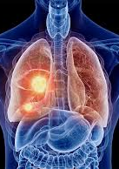
Secondary Conditions
Sleep Disturbances: Obstructive Sleep Apnea (OSA) is highly prevalent, with approximately 50% of adult asthma patients suffering from it due to airway inflammation
Digestive Issues: Gastroesophageal Reflux Disease (GERD) is frequently caused or exacerbated by chronic coughing and increased chest pressure
Cardiovascular Conditions: Increased lung strain can lead to pulmonary hypertension, right-sided heart enlargement (cor pulmonale), and heart failure

Slide 59
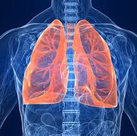
Secondary conditions
Mental Health Disorders: Chronic respiratory illness often leads to depression, anxiety, and extreme fatigue, largely due to activity limitations and breathing difficulties
Other Respiratory Issues: Complications like pneumonia, bronchitis, or chronic obstructive pulmonary disease (COPD) can arise from initial, less severe breathing issues
Chronic Pain/Headaches: Chronic sinusitis or migraines can be triggered by chronic inflammation

Slide 60
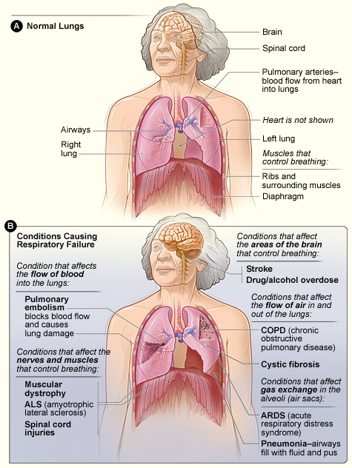
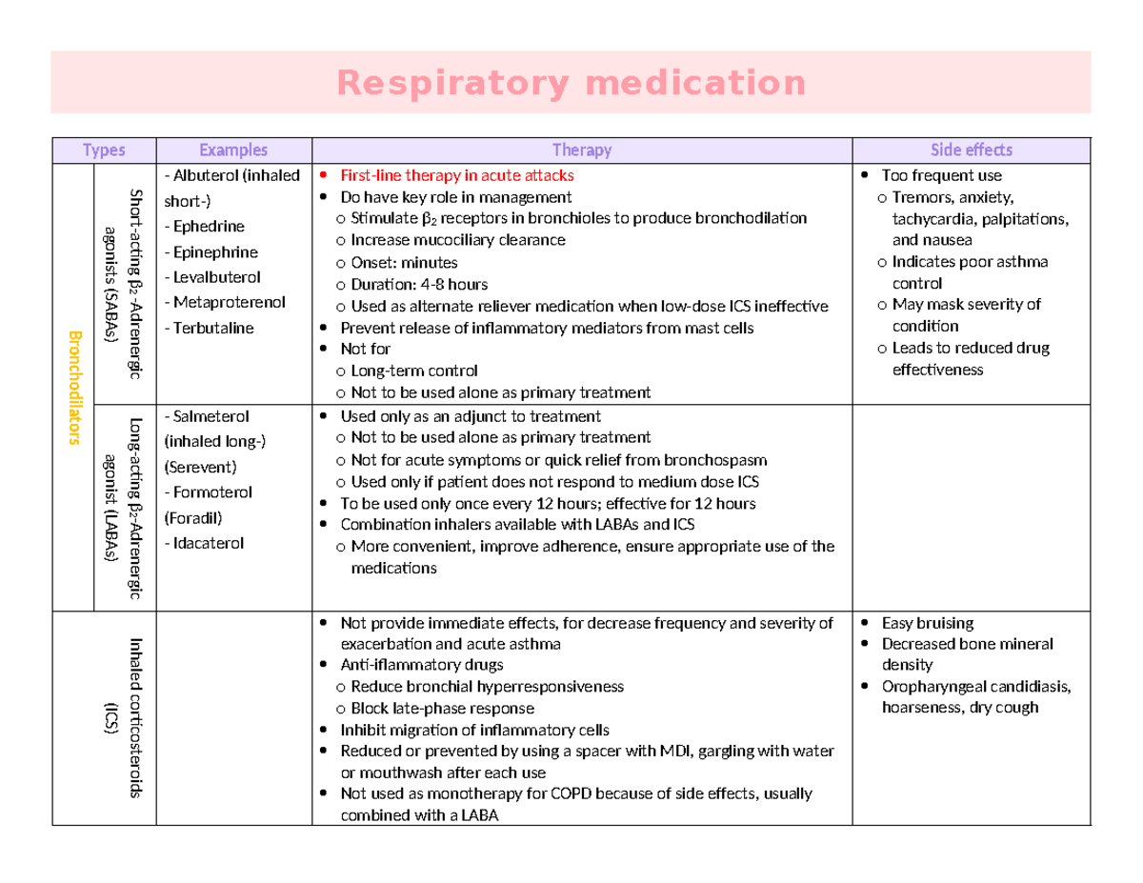

Slide 61
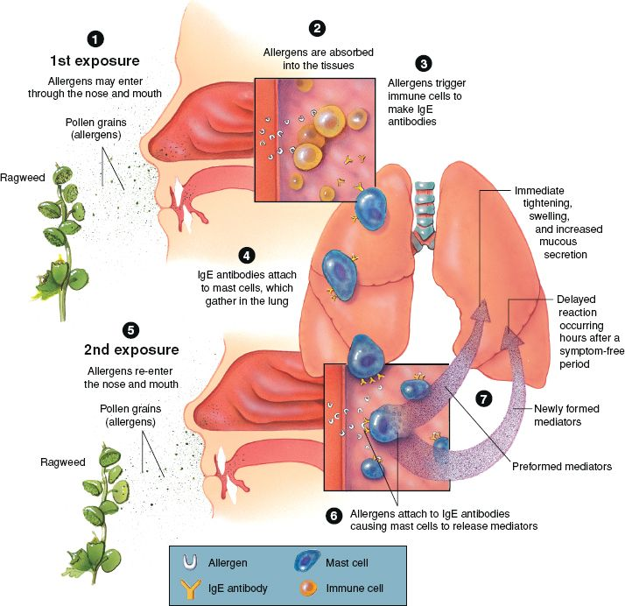
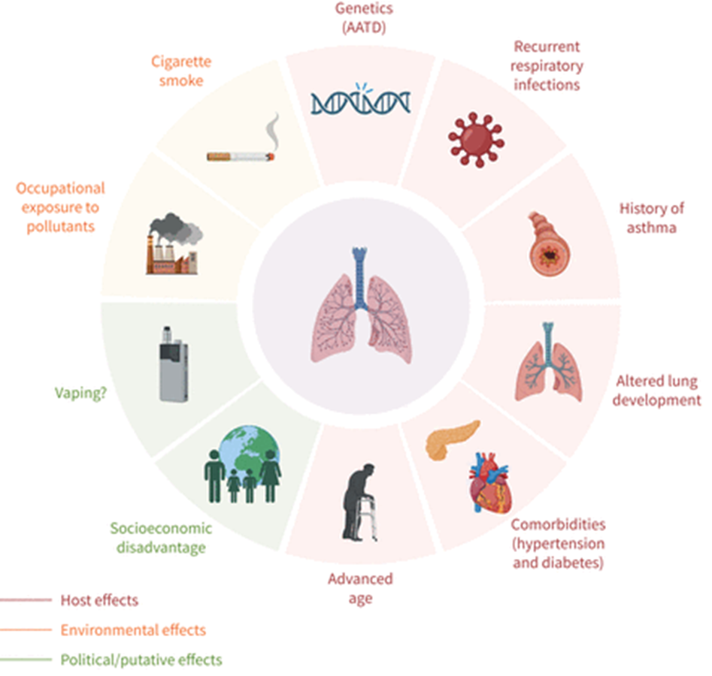
The How and What?
Toxic Exposures

Slide 62
Key Resources: CFR, M21, Case Law
Key Respiratory Conditions & Ratings (38 CFR § 4.97)
100% Ratings: Assigned for total laryngectomy, complete organic aphonia, severe stenosis (FEV-1 <40%), Wegener's granulomatosis, chronic bronchitis/COPD/emphysema (FEV-1 <40%), active pulmonary tuberculosis, and advanced interstitial lung disease.
Chronic Obstructive Pulmonary Disease (COPD) & Emphysema (DC 6603, 6604): Rated 10% to 100% based on FEV-1 and FVC levels.
Asthma (DC 6602): Rated 10% to 100% based on daily medication usage and FEV-1 severity.
Sleep Apnea (DC 6847): Rated 0% to 100% based on symptoms like daytime sleepiness and the need for breathing assistance devices (CPAP)
Rhinitis & Sinusitis (DC 6510-6522): Rated 10% to 30% or higher depending on the presence of polyps, obstruction, and required medical treatment
Presumptive Service Connection (38 CFR § 3.320)
Veterans who served in the Southwest Asia theater of operations or other designated areas (burn pit exposure) are eligible for presumptive service connection for: Asthma ,Rhinitis, Sinusitis.
Specific Respiratory Cancers: Squamous cell carcinoma of the larynx or trachea, and adenocarcinoma of the trachea
38 USC § 1120 (PACT Act): Presumes service connection for illnesses associated with burn pits/toxins, including respiratory cancers

Slide 63
Key Resources: CFR, M21, Case Law
Important Regulations & Policies:
Pyramiding (38 CFR § 4.96): The VA does not allow separate ratings for the same symptoms. For example, if a veteran has both asthma and sleep apnea, the VA will generally rate the one with the higher evaluation
Elevation: If a respiratory condition is severe and not fully covered by its diagnostic code, it may be elevated to the next higher rating
Particulate Matter Exposure: Conditions listed in 38 CFR § 3.320 must be manifested to any degree (including non-compensable) at any time following separation
M21-1, Part VIII.iii.7.C.1.b (TERA): Mandates a Toxic Exposed Veteran (TERA) medical exam if a claim is not clearly due to a non-toxic cause
Case Law:
Lay Evidence (Jandreau v. Nicholson)
Respiratory Condition Evaluation (Urban v. Wilkie)
Credibility of Exposure (VA Case Law)

Slide 64
Act III the finale

Slide 65
Remember to Listen
Don’t just Hear
Actively Listen to your Veteran
Remember the Mission: Old Glory
https://www.youtube.com/watch?v=3c7GqpoM6wU

Slide 66
Any Questions? Thank you !

