Slide 1
ETHICS
WISCONSIN COUNTY AND TRIBAL VETERANS SERVICE OFFICERS – SPRING 2026

Slide 2
ETHICAL CONSIDERATIONS IN THE ROLE OF A CTVSO
PERSONAL ETHICS
COUNTY/TRIBAL APPLICATION AND POLICY
STATE APPLICATION AND POLICY
FEDERAL APPLICATION AND POLICY

Slide 3
ETHICS - DEFINED
Meriam – Webster Dictionary defines ethics as the principles of conduct governing and individual or group.
OR
A set of moral principles: a theory or system of moral values

Slide 4

DO THE RIGHT THING, EVEN WHEN NO ONE IS WATCHING

Slide 5

And definitely DO THE RIGHT THING when someone is watching

Slide 6
ETHICS IN DAILY CTVSO APPLICATIONS
Gifts as a “Thank You” for helping with claims.
Discussing privileged information.- many of us live in areas where people we know outside of the job know our clients. Don’t discuss clients outside of the office.
Some clients may have familial or social relationships. – Again don’t discuss.
Some clients may be submitting claims that we have our own personal doubts about. – difference between knowingly fraudulent and not valid claims. Sometimes Veteran insists.
Of course all of the financial and PII we have access to.

Slide 7
ETHICS IN DAILY CTVSO APPLICATIONS
Examples from the group.

Slide 8
THINGS GONE WRONG
Michigan county's veterans services director sought cash, gifts from veterans STARS AND STRIPES • January 8, 2015
“We will discuss a gentleman’s agreement to compensate for my personal time,” Losey wrote. “I have worked cases for veterans who reside outside Calhoun County over the past couple of years with the same kind of agreement. I will not gouge you like your Social Security lawyer. Perhaps 7 to 10 percent is typically the agreement. I have had veterans screw me over big time as well. Does this sound cool?”

Slide 9
THINGS GONE WRONG…cont.
Losey also said in one of the emails to a veteran that “a few pain meds from your stash will suffice for now,” and in another that “I suppose now is as good as any to request one month truck payment as a confidential gentleman’s agreement for a job well done.”
“When the decision comes back as a winner and you receive that big fat retroactive check,” he wrote in an email dated May 22, 2014. “I need $1,600 to repair my transmission and YOU are going to help me out. DEAL?”

Slide 10
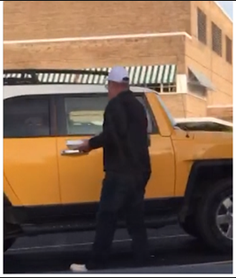
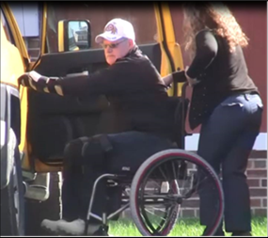
THINGS GONE WRONG….cont. GRAND RAPIDS, MICHIGAN — Joseph Scott Gray, 53, of Lawton, Michigan was sentenced to five years in federal prison for lying to the Department of Veterans Affairs to obtain over $250,000 in benefits to which he was not entitled. To obtain those benefits, Gray repeatedly told the VA he could not walk or stand, when in fact, he could. On October 26, 2017, Gray went to the Battle Creek VA Medical Center for an exam, and he arrived in a wheelchair. During the exam, Gray told VA employees he had not walked in 10 years and could not use his left hand. Minutes later, Gray went to a local restaurant, where he was observed freely walking in and out of the building and carrying his leftovers in his left hand:

Slide 11
County and Tribal Veterans Service Officers Association of Wisconsin
Code of Ethics
All members of this association must be committed to the highest standards of conduct in the performance of his or her duties. Individual and collective adherence to the highest ethical standards is essential to the maintenance of public trust and confidence.
While members must agree on the need for proper professional conduct, they may experience personal conflict or differing views of values and loyalties. In such cases, the principles contained in this Code of Ethics provide valuable guidance in reaching decisions that are governed, ultimately, by the dictates of the individual conscience of each member and his or her commitment to the public good.

Slide 12
COUNTY/TRIBAL SPECIFICS
Employee Handbook
Human Resources
Corporation Counsel

Slide 13
GREEN COUNTY SPECIFICS
Employee Handbook:
Not allowed: Soliciting or accepting unauthorized compensation, reward, gratuity or gift of any kind or value for any matter related to the employee's job as an employee of the County.
In practice, Corp Counsel says less than $10.
OK examples: flowers, cheese curds, bluegill fillets
Not OK: money, prescription medication, TRANSMISSION repairs.

Slide 14
State of Wisconsin
As defined in Chapter 45
No major issues, other than violating State law.

Slide 15
FEDERAL VETERANS ADMINISTRATION
VARIOUS COMPONENTS
VA CYBER SECURITY AND FEDERAL TAX INFORMATION TRAINING ON TMS.
NUMEROUS CRITERIA AS ACCREDITED REPRESENTATIVES.
VA HEALTHCARE INFORMATION
CLAIMS

Slide 16
FEDERAL VETERANS ADMINISTRATION
§14.632 Standards of conduct for persons providing representation before the Department(a)
(1) All persons acting on behalf of a claimant shall faithfully execute their duties as individuals providing representation on a particular claim under § 14.630, representatives, agents, or attorneys.
(2) All individuals providing representation are required to be truthful in their dealings with claimants and VA.

Slide 17
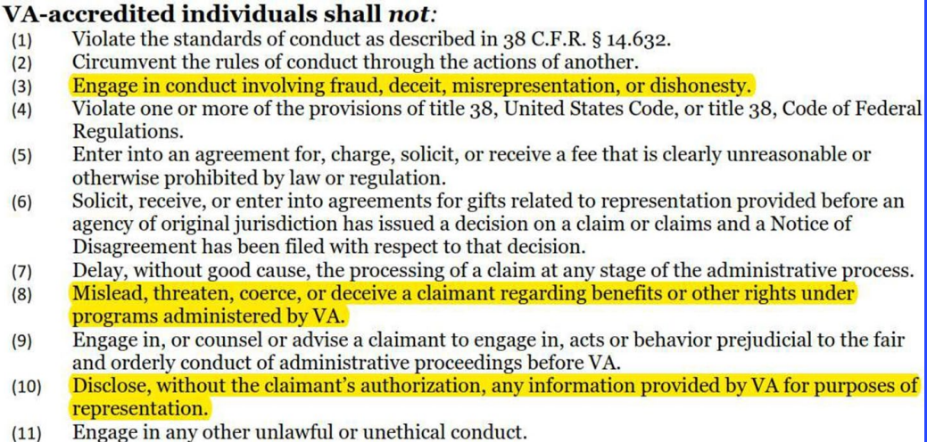
FEDERAL VETERANS ADMINISTRATION

Slide 18
WORST CASE SCENARIO
Federal : Loss of accreditation, which can lead to loss of job
County: Loss of job

Slide 19

WORST CASE SCENARIO
OR POSSIBLY EVEN

Slide 20
PRACTICAL APPLICATION CONSIDERATIONS
You only have so much time in a day.
You have Veterans with what appear to be varying levels of legitimacy in their claims.
Do you provide the maximum level of service or do you sometimes do just enough to fulfill your legal obligations?
Difference between rural versus urban populations and hours able to devote to a claim.

Slide 21
PRACTICAL APPLICATION CONSIDERATIONS
Do you have Veterans that receive commission funds (or other donations) keep repeatedly coming back, or do their Veteran friends suddenly end up needing assistance?

Slide 22
PRACTICAL APPLICATION CONSIDERATIONS
Frivolous claim versus Not
Case Study. M.N.
Guys says he’s a Vietnam Vet 0311. DD-214 shows the only award is a rifle marksmanship badge. No foreign service. 8 periods of lost service (confinement or AWOL).Under conditions Other Than Honorable discharge.
Wants to file for VA benefits related to Vietnam.
NPRC only sends 214 due to discharge status.

Slide 23
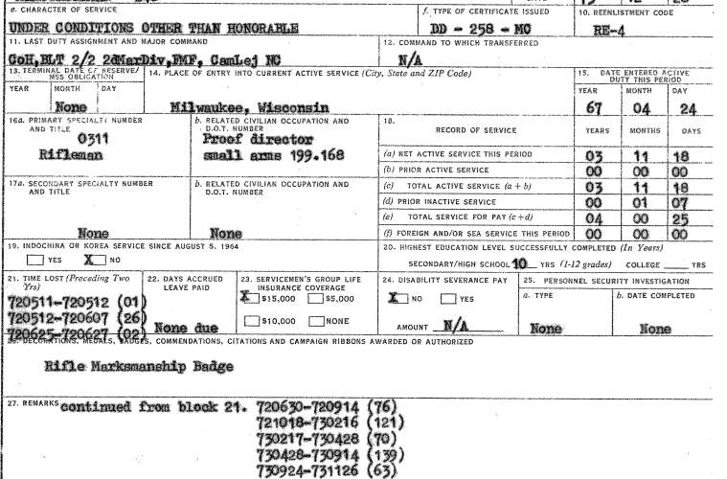
PRACTICAL APPLICATION CONSIDERATIONS….cont.

Slide 24

PRACTICAL APPLICATION CONSIDERATIONS….cont.

Slide 25
PRACTICAL APPLICATION CONSIDERATIONS…Cont.
Veteran paid NPRC for records. – records not free due to discharge. This could have ended all our interactions with the Vet, but he followed up.
Veteran was incarcerated at Camp Lejeune brig.
Veteran served two tours in the Marine Corps infantry in Vietnam – second tour during the battle of Hue City.
Veteran was admittedly a terrible garrison Marine. Requested his second tour to Vietnam to get out of the brig.
We got his discharge upgraded to General. Got access to VA healthcare. Got service connected at 100%. Wife currently receiving DIC.
What if we told him there is nothing for him due to his discharge status?
Sometimes we need to just listen to the story and follow up with paperwork to see where things go.

Slide 26
PRACTICAL APPLICATION CONSIDERATIONS…Cont.
Fraudulent or Frivolous claims:
Knowingly makes or assists in making a false statement concerning a claim for VA benefits.
You must be able to make a good faith argument based on the merits of the claim.
We need to be careful in being an advocate for the Veteran, yet at the same time, ensure the Veteran does not sabotage their own claim.
We do not have to represent a client. If something seems off, use language “Veteran insists” or similar statement.

Slide 27
CONCLUSION
TRY TO DO THE RIGHT THING
GRAY AREA VERSUS BLACK AND WHITE
GROUP DISCUSSION

Slide 28

Some information sourced from South Dakota DVA power point presentation.

