Slide 1
VA Debt Management Center (DMC)
Veterans Service Organization Presentation
CTVSOA April 2026

Slide 2
Agenda
DMC overview
Debt establishment
Collection process
Debt resolution options
Risks of non-payment
Contact Information
Questions

Slide 3
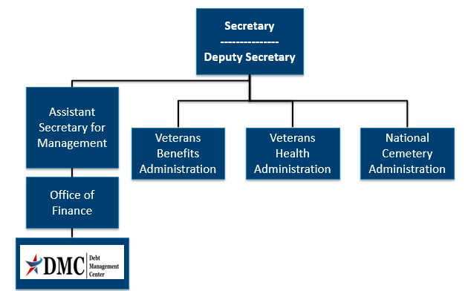
Organization Chart

Slide 4
DMC Mission
Provide distinctive, high quality accounts receivable services through a compassionate and value-added approach, empowering our stakeholders to focus on core missions.

Slide 5
Debt Establishment
Regional Office (RO)/Regional Processing Office (RPO) Receives information
RO/RPO Processes Claim/Award
DMC Collects Debts
Sends notification letters for debts
Sends a letter when payments are issued or debt created
Processes collection actions
Evaluates eligibility/ entitlement
Issues payments and establishes debts
Education Certification
Change in circumstances affecting benefit eligibility or entitlement
Provides debt relief and resolution options

Slide 6
Impacts to Eligibility/Potential Debt
Pension
Changes in income or net worth
Education
Withdrawal from class
Not attending class
Changes in dependent status
Class did not count toward graduation
Compensation
Active-duty time
Drill pay days
Changes in dependent status
Change in active-duty status
Fugitive felon status/incarceration
Fugitive felon status/incarceration

Slide 7
Collection Process
DMC sends Notice of Indebtedness letters, monitors accounts, and advises debtor of any delinquency, including the requirement to refer their account to Treasury
DMC Sends 1st Letter
30 or 90 days
DMC Sends 2nd Letter
30 days
DMC Sends 3rd Letter
If DMC receives payment, next collection letter is deferred
Treasury Cross Servicing (CS)
60 days
Treasury Offset Program (TOP)
60 days

Slide 8
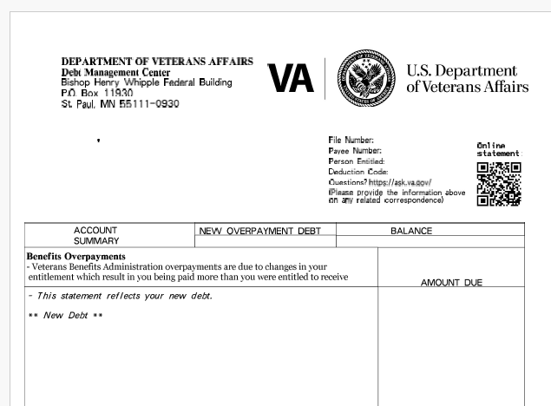
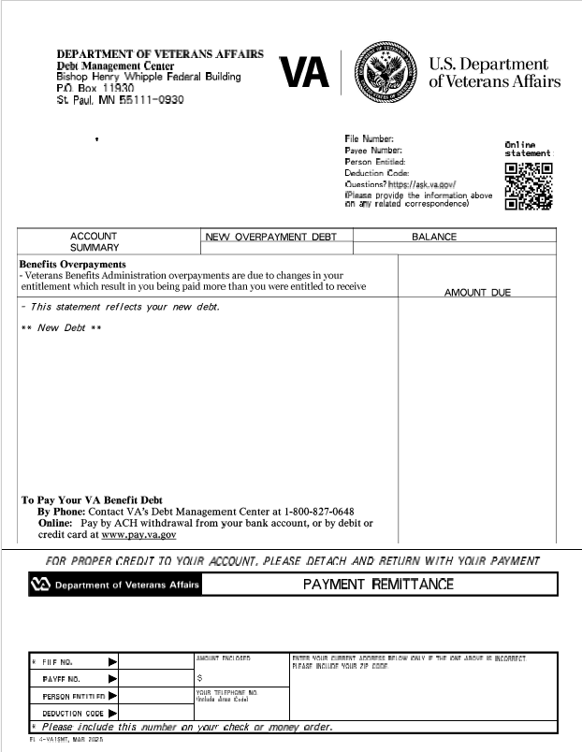
DMC Debt Letter 1 of 2

Slide 9
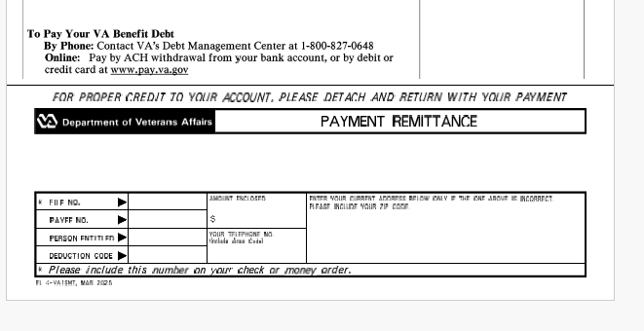
DMC Debt Letter 2 of 2

Slide 10
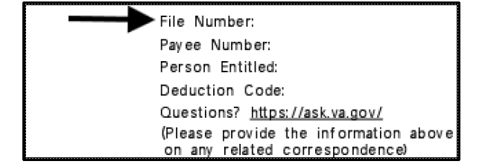
Update to Education Debt Identification
DMC has transitioned from using VA File Number or SSN to a debt specific Receivable ID for each education debt to improve security
The RID is displayed on education debt letters in the file number field at the top right. You will know it is the RID if the entire number is visible (file numbers only showed the last four digits when displayed in this space).

Slide 11
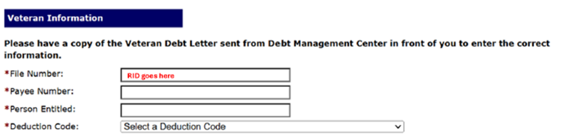
RID and Pay.va.gov
Receivable ID is required instead of File number on pay.va.gov for all education debts
Pay.va.gov still looks the same, however RID will go in place of the file number for education debts
If a debtor has multiple EDU debts, they must make individual payments per RID
Compensation and Pension debts still input the file number (no change)

Slide 12
Relief and Resolution, or Referrals
DMC sends Debt Notice(s)
Contact DMC
Relief and Resolution:  Pay In Full
· Reduced Benefit Offset
· Payment plan
· Compromise
· Waiver/Waiver Reconsideration
· Dispute
· Temporary Suspension
No Action/ Payment
· Benefits offset in Full
· Referral to:
- TOP
- Cross-Servicing

Slide 13
FAQ: Dispute vs. Waiver?
Dispute
Written statement from beneficiary
Questioning whether debt is still outstanding
Questioning whether debt amount is accurate
Waiver
Written statement from beneficiary
Explaining why they should not be responsible for payment of the debt
Explaining why collection of the debt would be unfair
Explaining why the debt is creating financial hardship
Helpful to state “I request a waiver”
Also provide VA Form 5655 Financial Status Report

Slide 14
FAQ: What makes a “good” waiver request?
Answer: There is no formula to guarantee the outcome of a waiver. Here are some things to bear in mind:
Indication of fraud, misrepresentation, or bad faith precludes granting of a waiver (See 38 U.S.C 5302(c) )
Request should explain facts and circumstances to enable the committee to consider the standards of equity and good conscience (see 38 C.F.R 1.965 for more details ):
- fault of debtor - balance of faults
- undue hardship - defeat the purpose
- unjust enrichment - changing position to one’s detriment
An accurate VA Form 5655 Financial Status Report facilitates evaluation of financial hardship

Slide 15
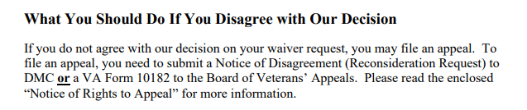
Waiver Reconsideration vs. Appeal?
Language from Committee on Waivers and Compromises (COWC) letter:
*** Veterans should not use VA form 10182, 20-0996, or 20-0995 to appeal a waiver decision with DMC***
Notes:
.

Slide 16
Appealing a Waiver Decision continued
Send to | Form to use | Info to include | Reviewed by | Stops collection?
DMC | None- request must be in writing | Indicate request is for reconsideration of waiver decision, include support for reconsideration | COWC | No
BVA | VA Form 10182 | Complete form including signature | Board of Veterans Appeals | No

Slide 17
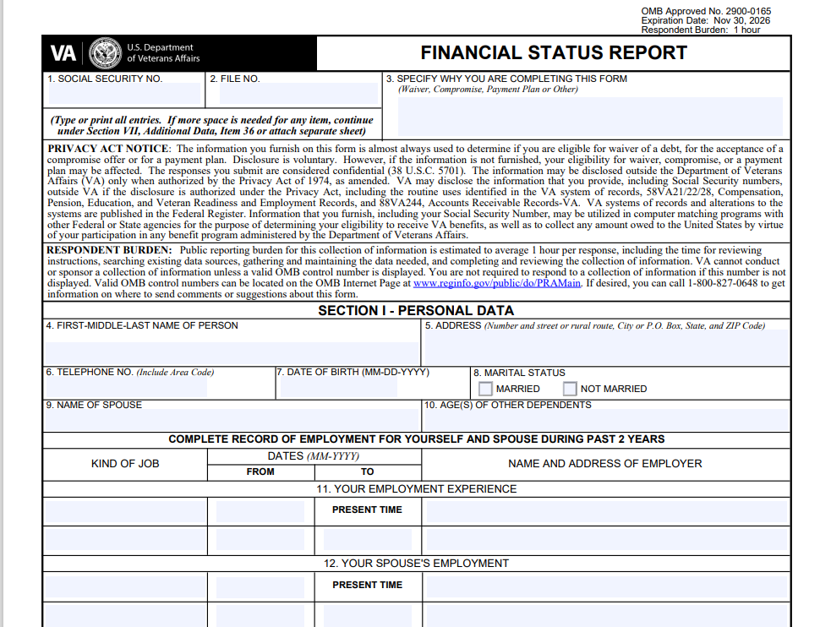
VA Form 5655 Financial Status Report
Box 3 lists the reason for the form, accuracy here is helpful
Multiple processes can be requested on one PDF form

Slide 18
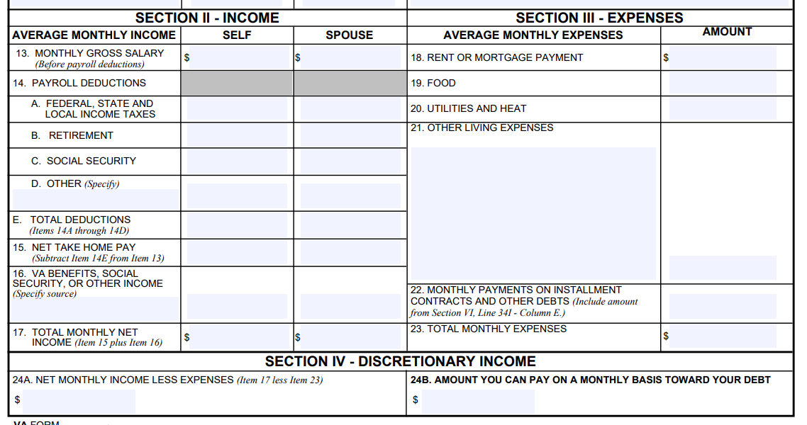
VA Form 5655 Financial Status Report
Be thorough on income and expenses
Box 22 brings in total from back of the form
Box 24A should equal Box 17 total minus box 23
24B is key!

Slide 19
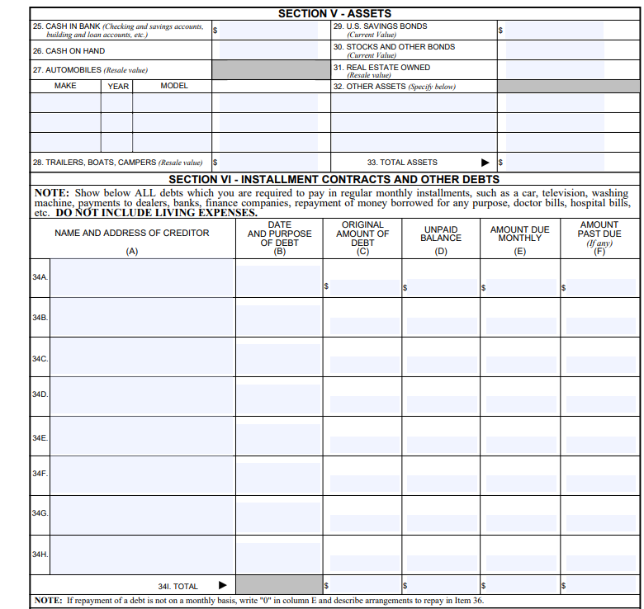
VA Form 5655 Financial Status Report
Back of form lists assets and debts to give fuller picture
Total monthly payments on debts from row 34 I column E gets included on the front of the form in Box 22

Slide 20
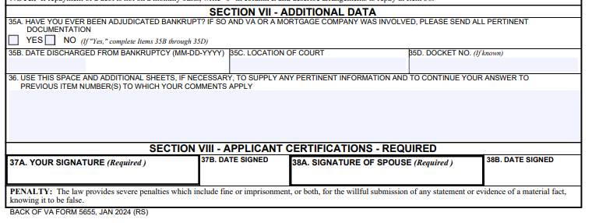
VA Form 5655 Financial Status Report
Signature is key (both if has spouse)
Box 36 is optional but written statement in some form recommended

Slide 21
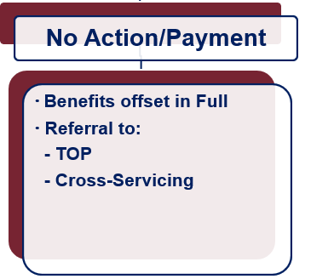
What if Payment is not Made?
Future VA benefits awarded will be withheld to satisfy debt
Department of Treasury
Offset of Federal payments
Referral to private collection agencies
Administrative Wage Garnishment Program

Slide 22
VA Debt Portal for Veterans
Debt Portal: https://www.va.gov/manage-va-debt/
Veterans can log in to view balances
FAQ’s
Email notifications to Veterans
Online VA Form 5655 Financial Status Report (FSR) with “wizard”
Online Dispute
More enhancements to come

Slide 23
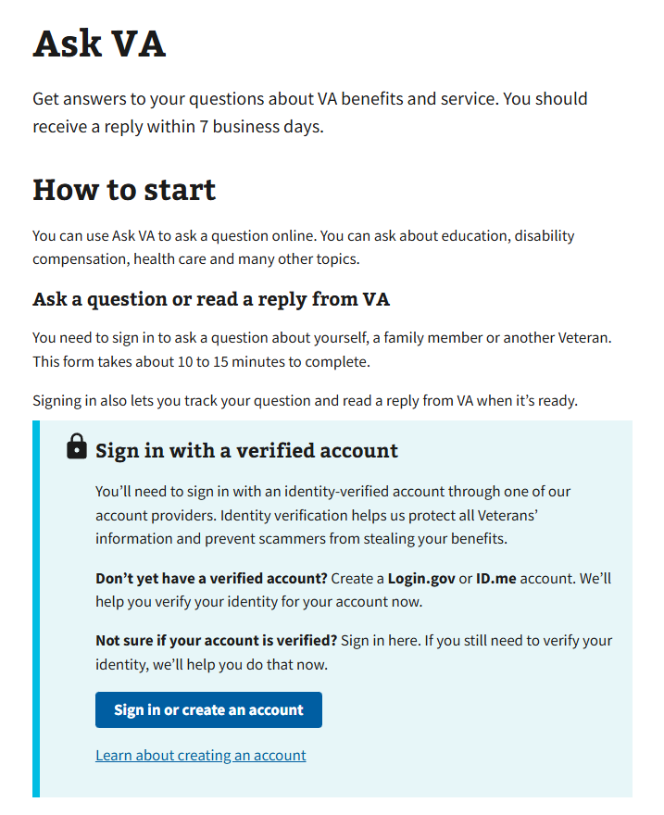
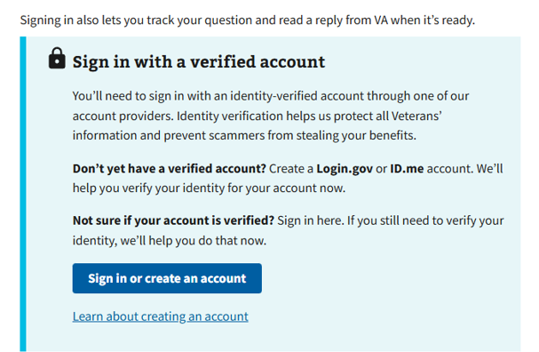
Ask VA (AVA)- DMC Tips
Located at https://www.va.gov/contact-us/ask-va/introduction

Slide 24
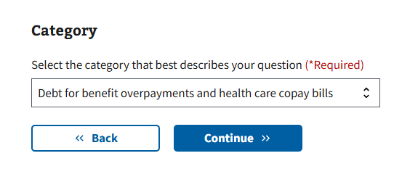
AVA- DMC Tips
Options to reach DMC are found under “Debt for benefit overpayments and health care copay bills” category

Slide 25
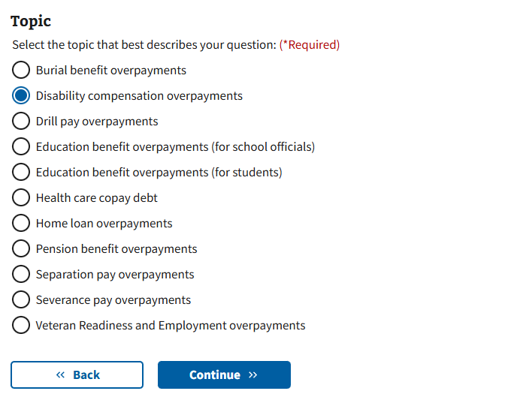
AVA- DMC Tips
Topics are used to select the type of debt for proper routing.
The following debt topics are NOT DMC jurisdiction, all others will route to DMC:
Health care copay debt
Severance Pay
Separation Pay

Slide 26
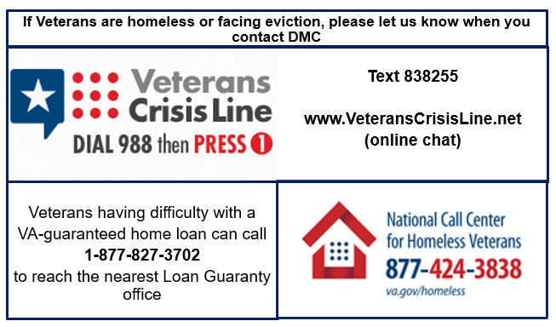
At Risk Veterans

Slide 27
Other Financial Information: FINVET
National Veterans Financial Resource Center
FINVET website: https://www.mirecc.va.gov/visn19/finvet/
Connects Veterans to financial resources and tools to improve financial well-being and literacy (FINVET does not provide financial assistance)

Slide 28

Become a Debt Superstar (Contact DMC)
https://www.va.gov/manage-va-debt/ | Veteran Debt Portal
https://www.va.gov/contact-us/ask-va/ | Online inquiry system
800-827-0648 | DMC Veteran Toll Free Line
612-970-5688 | Fax
844-261-6570 | DMC VSO Only Line

Slide 29
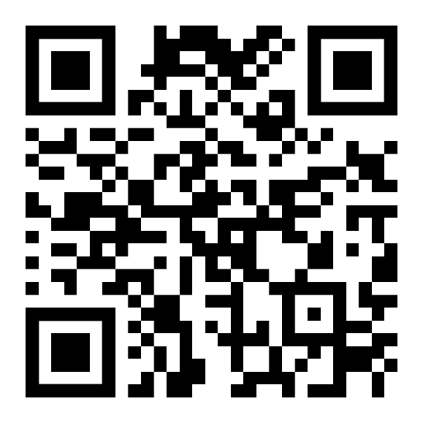
DMC Presentation Survey
DMC values your time and feedback on our presentation. We would appreciate it if you’re able to complete the survey below.
https://www.surveymonkey.com/r/DMCVSO

Slide 30
Additional Information

Slide 31
Pay in Full
Pay by check: mail the check, payment coupon(s) and/or letter to:
VA Debt Management Center
Bishop Henry Whipple Federal Building
P.O. Box 11930
St. Paul, MN 55111-0930
Pay online: www.pay.va.gov
Pay by telephone: 800-827-0648

Slide 32
Withholding VA Benefits
Automatic 36-month repayment plan for compensation and pension debts
Automated 12-month repayment plan for education debts
If debtors have financial hardship, please have them contact DMC
VA Form 5655, Financial Status Report, is required for any reduced withholding arrangement beyond 60 months

Slide 33
Compromise
Debtors should send letter to DMC indicating “compromise offer” and specifying amount
Offer should be a “lump sum”
Offer must include VA Form 5655
DMC refers offers to the Committee on Compromises
*** Payment should not be sent until the debtor receives a decision accepting the offer***

Slide 34
Waiver
Debtors have one year from date of first DMC debt letter to request waiver
Request must be:
Made in writing and submitted to DMC
Include VA Form 5655 Financial Status Report
Explain why debtor is unable to repay the debt
Received in the first 30 days for Education or 90 days for C&P debt to stop collection action

Slide 35
FAQ: What makes a “good” waiver request?
Answer: There is no formula to guarantee the outcome of a waiver. Here are some things to bear in mind:
Indication of fraud, misrepresentation, or bad faith precludes granting of a waiver (See 38 U.S.C 5302(c) )
Request should explain facts and circumstances to enable the committee to consider the standards of equity and good conscience (see 38 C.F.R 1.965 for more details ):
- fault of debtor - balance of faults
- undue hardship - defeat the purpose
- unjust enrichment - changing position to one’s detriment
An accurate VA Form 5655 Financial Status Report facilitates evaluation of financial hardship

Slide 36
Dispute
Debtors can dispute the existence or amount of the debt created by VBA
Dispute must be in writing
DMC forwards disputes to the Regional Office/Regional Processing Office of jurisdiction
Veterans can now submit through online debt portal

Slide 37
Temporary Suspension
Disaster Relief
Case by case financial hardship
Does not extend timeline to request waiver

Slide 38
FAQ: What happens when a debtor dies?
Answer: DMC reviews the account and may request funds from the debtor’s estate. Some things to bear in mind:
VA does not prorate monthly benefits when someone dies, so the payment for the month of death often creates a debt
Surviving spouses may be eligible for a month of death benefit, and if eligible that payment must be issued to the surviving spouse by VA, they cannot keep a payment VA issued to their deceased spouse. The Regional Office handles issuing month of death payments for eligible surviving spouses
Unless there is fraud, VA does not pursue collection from a specific individual, but rather from the estate of the deceased debtor

Slide 39
VHA Debts
For questions about medical care and pharmacy services copayment debt, contact the Health Resource Center:
1-866-400-1238
VA has options for Veterans who suffer from difficult financial circumstances and struggle to pay VA copayments:
Health Resource Center: 1-866-400-1238
https://www.va.gov/COMMUNITYCARE/revenue_ops/Financial_Hardship.asp

Slide 40
Federal Debt Collection Laws
The Debt Collection Act of 1982
Authority for collection by administrative offset
The Debt Collection Improvement Act (DCIA) of 1996
Agencies required to refer delinquent non-tax debts to the Department of Treasury at 180 days
Digital Accountability and Transparency Act (DATA) of 2014
Changed referral requirement for delinquent non-tax debts from 180 days to 120 days

