Slide 1
5302B Cleland Dole ACT

Slide 2
Agenda
What is it - Background
Definitions
External Calculator
Administrative Decision
What it looks like in file

Slide 3
Background

Slide 4
Public Law (PL) 117-328 Joseph Maxell Cleland and Robert Joseph Dole Memorial Veterans Benefits and Healthcare Improvement Act of 2022
Enacted: December 29, 2022
Subtitle E: VA Beneficiary Debt Collection Improvement Act
Amended Chapter 53 of Title 38 U.S.C.
Inserted 38 U.S.C. 5302B
AKA : Cleland-Dole Act

Slide 5
38 USC 5302B Prohibition of debt arising from overpayment due to delay in processing
Also referred to as 5302B
May not incur untimely debt
Must provide notice of the debt
Must include explanation of the right to:
Dispute the debt
Request a waiver of the debt

Slide 6
Secretary of Veterans Affairs Temporary Timeliness Instructions
Memo Dated December 22, 2023, Establishes a 1 year timeliness period
Decision Notification provided within one year of Date of Claim
Beneficiary delays extend timeliness period
No debt past timeliness period
Effective June 27, 2023

Slide 7

Special Note: The bill was enacted December 29, 2022; however VA did not start processing these adjustments until December 8, 2025. There be a retroactive review of claims finalized before 12/8/2025 but subject to 5302B?

Slide 8
Prevention of Debt due to Processing Delays under 38 U.S.C. 5302B
What this does:
Applies SECVA instructions
Defines new terminology
Outlines Procedures
Administrative decision template
38 U.S.C. 5302B external Calculator
38 U.S.C. 5302B VBMS-A Embedded Calculator

Slide 9
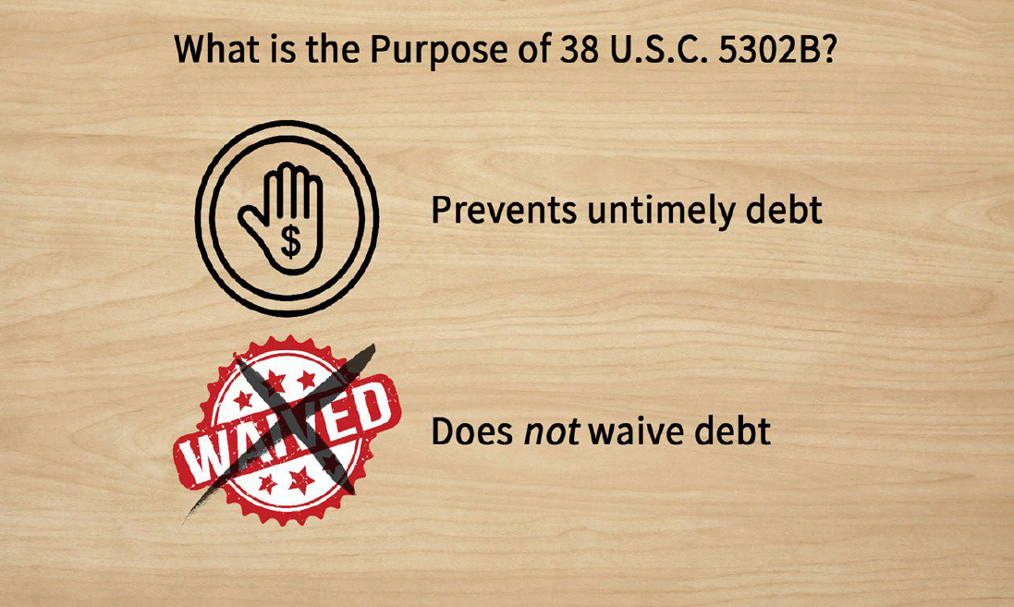

Slide 10
Definitions

Slide 11

On Behalf of a beneficiary: information received from the following: * Designated representative of record * Fiduciary * Third Party * Through Matching agreement (SSA, BOP)

Slide 12
5302 Start date: The earliest date VA receives or is notified of information from any source ordinarily treated as a basis for initiating an adjustment to benefits that results in potential debt. Timely Decision due Date: The date of which VA is required to provide a decision and associated notice to comply with 38 U.S.C. 5302B 5302B Period: the time frame during which the overpayment was not incurred. Last Paid date: The date through which the beneficiary has received their last payment.

Slide 13
Timeline for 5302B

Slide 14
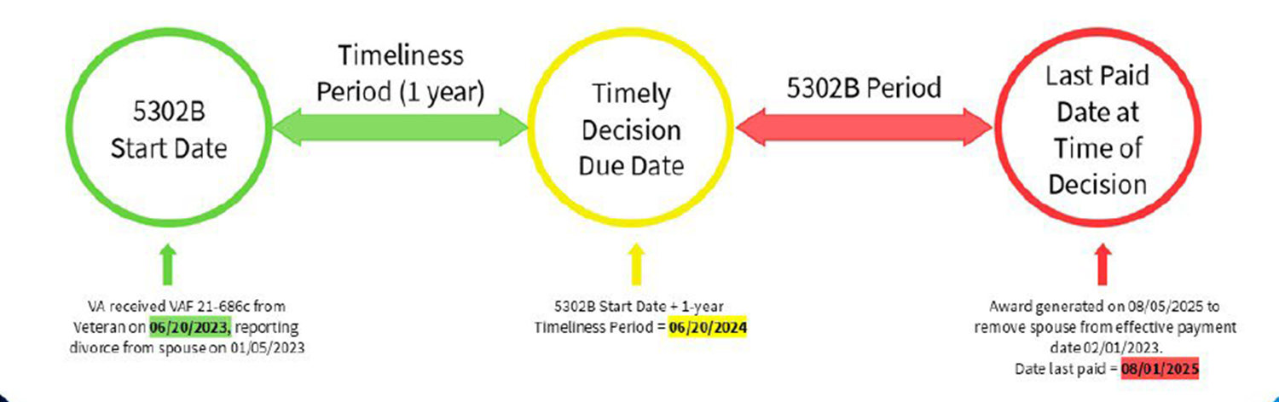
Timeline without a delay attributable to Beneficiary

Slide 15
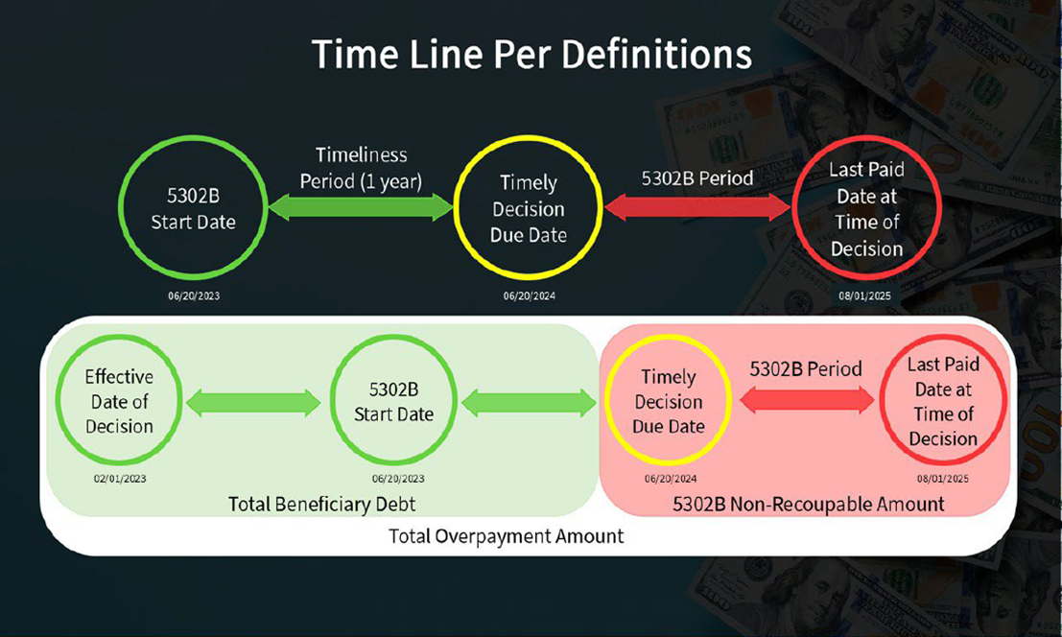
Timeline

Slide 16
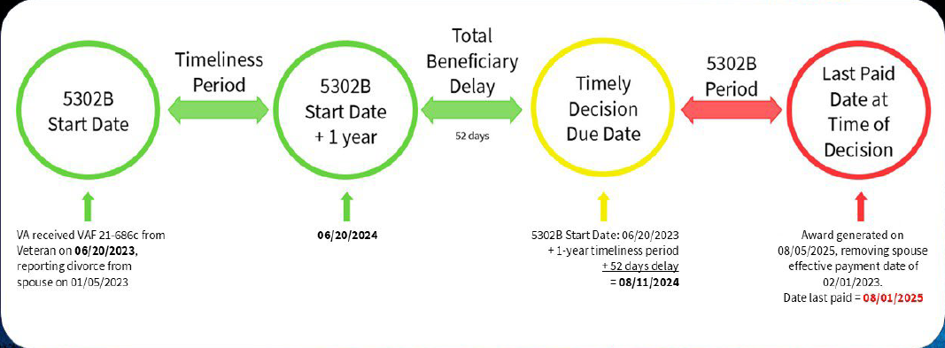
Timeline with delay attributable to Beneficiary

Slide 17
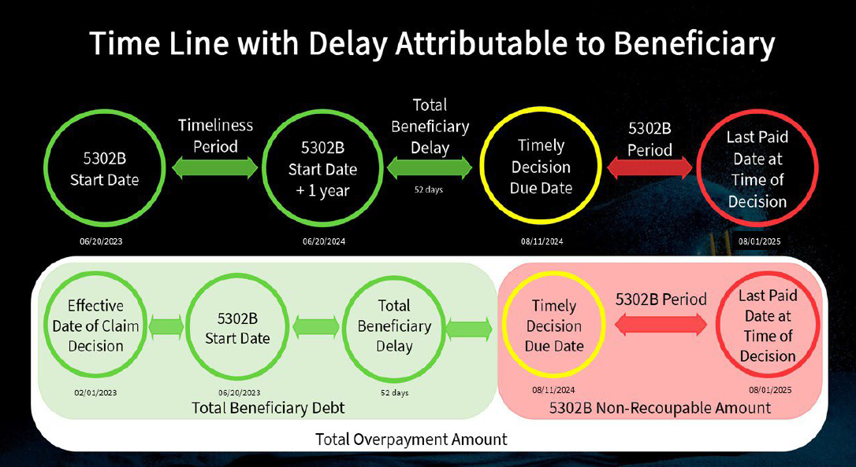
Timeline

Slide 18
External Calculator: Extending the Timeliness Period

Slide 19
Delays Directly attribuatable to Beneficiary’s Actions: days attributable to beneficiary’s request, inaction, or failure to cooperate. Total Beneficiary Delay: Number of days attribuate to the beneficiary that extends the timeliness period, outside their basic due process rights.

Slide 20
Delays Directly attributable to Beneficiary’s Actions: * request for extensions to submit evidence *request for rescheduling of hearing * request for rescheduling of examination * returned mail and actions taken to resolve Delays NOT Attributable to Beneficiary’s Actions: * Initial request for hearing * Initial request for examination * returned mail due to VA’s error

Slide 21
External Calculator

Slide 22
Scenario: *Veteran reported Divorce on 06/20/2023 *Date of divorce: 01/05/2023

Slide 23
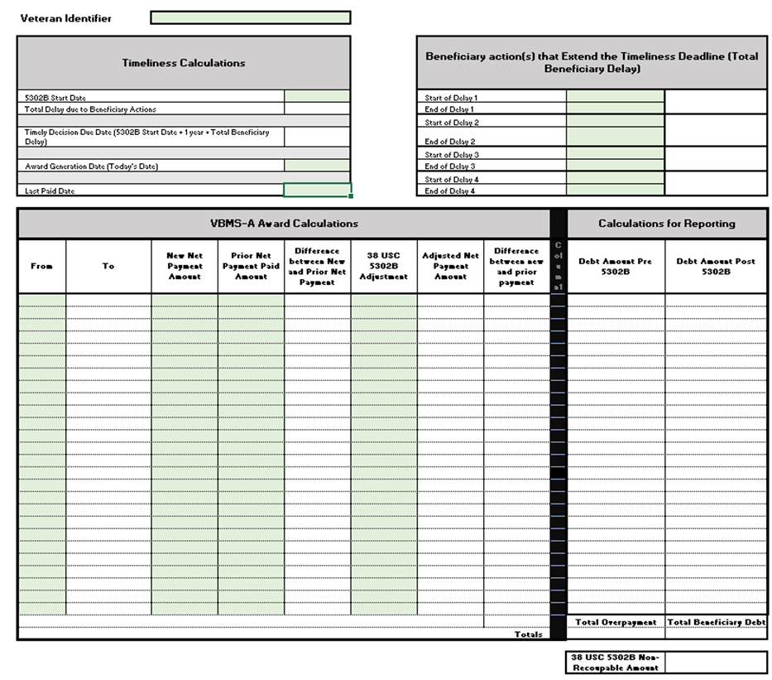
5302B Calculator

Slide 24
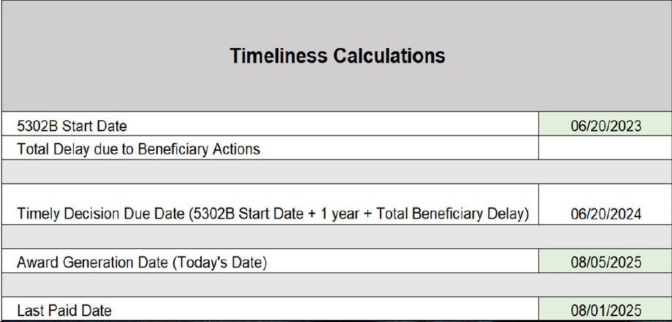
5302B Calculator

Slide 25
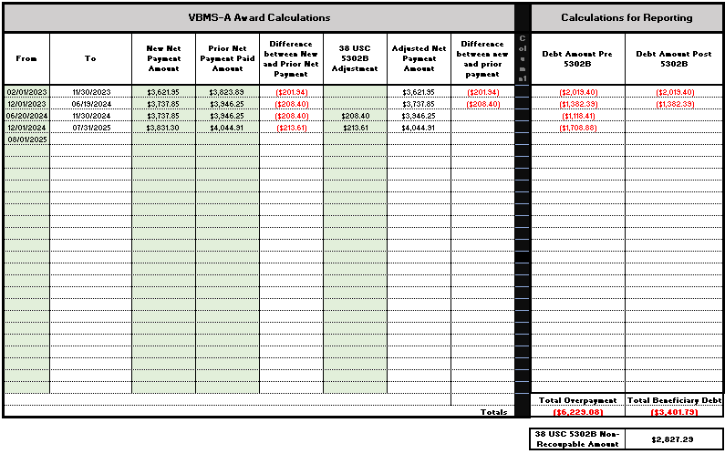
5302B Calculator

Slide 26
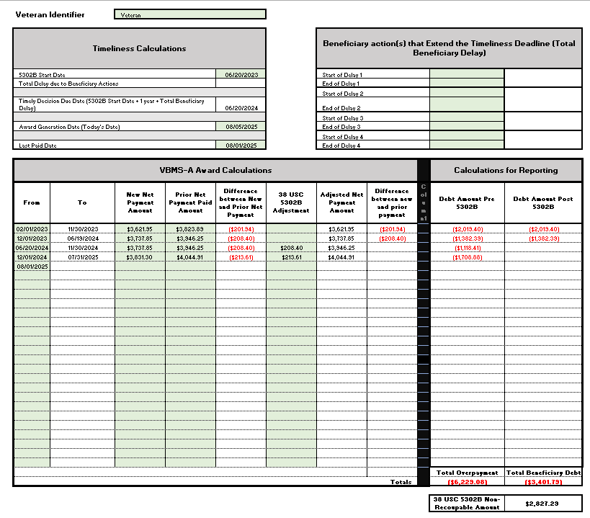
5302B Calculator

Slide 27
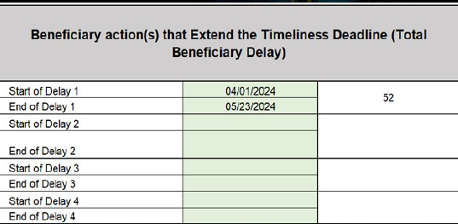
Example: Extending the Timeliness Period: Veteran failed to report to a requested hearing on 4/01/2024 Request to reschedule hearing on 4/01/2024 Subsequent hearing conducted on 05/23/2024

Slide 28
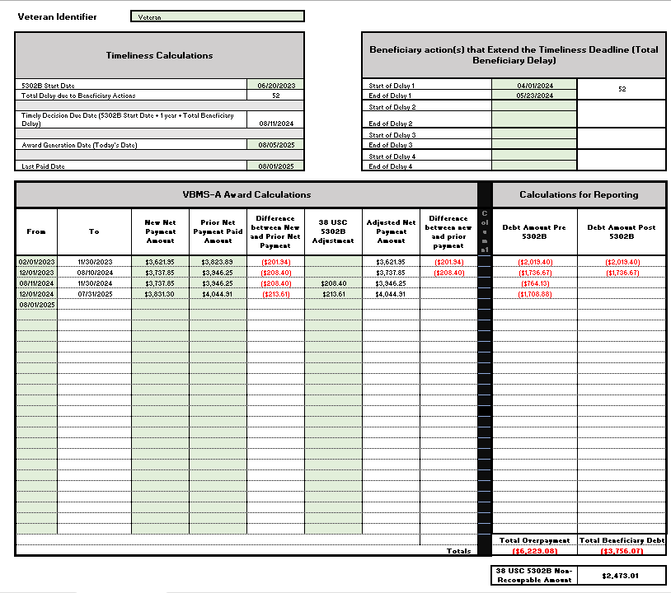
5302B Calculator

Slide 29
Administrative Decision

Slide 30
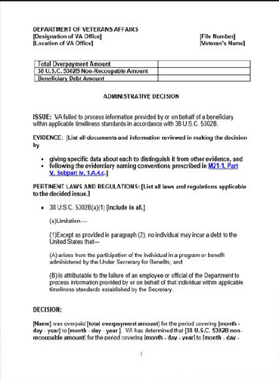
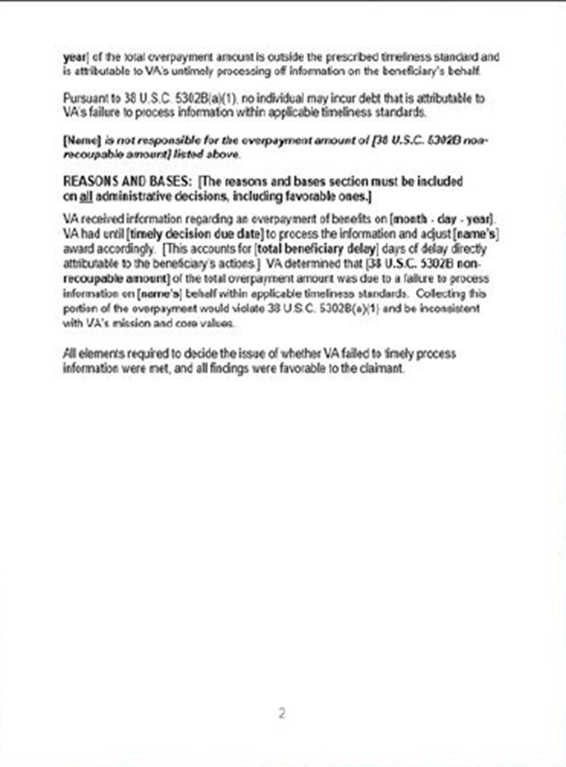

Slide 31
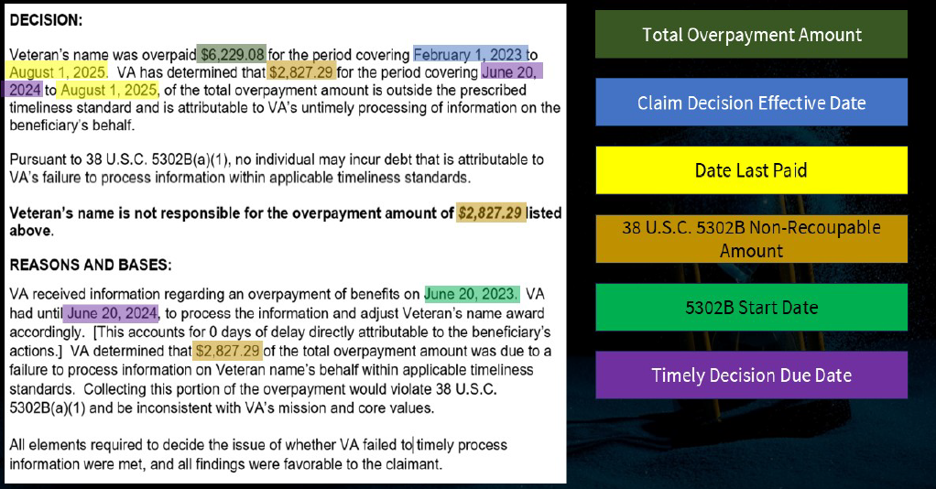

Slide 32
Applicability of SOP All Cases in which overpayment is pending or established on or after June 27, 2023 Exceptions to SOP Applicability: * Evidence of fraud, misrepresentation, or bad faith * does not relieve of responsibility to provide current information * does not apply to SSA income match cases from June 24, 2022

Slide 33
Question: It is noted that the bill was enacted December 29, 2022, however VA did not start processing these adjustments until December 8, 2025. Will there be a retroactive review of claims finalized before 12/8/2025 but subject to 5302B? Answer: Yes, a rework project is in the works along with additional guidance for claims that fall under this timeline.

Slide 34
Thank You
Johnathan Bahde
Milwaukee BEST

