Slide 1

CVSO Best practices
Paul Crawford
Rock County CVSO

Slide 2
One team, one fight
Target the best practices to achieve positive results for our veterans
Find new ways to help, collaboration is key
Please ask many questions and offer your input

Slide 3
You’re the expert
It is not the veteran’s job to know the ins and outs of VA
It is not our job to tell a veteran something is service-connected or not
Tell the VA what you want them to do, do not ask them
Do not be the VA…Do not be a C&P examiner
  BE BETTER!!!

Slide 4
Claims
Do you have the 3 elements per law?
  Current and Chronic Diagnosed Condition
  Evidence of incurrence of aggravation in service
  Nexus
  38 CFR 3.303, 38 CFR 3.304

Slide 5
Claims
Research Research Research
Look into the STR’s, Look into Medical Records
If VA, send a 10-5345 ROI for Active Problem List
“I don’t remember going to medical.”
“I don’t know, I take medication for something…”

Slide 6
Claims
Build for the board, do not rely on the board
Find the answer
HLR and Supplementals are good

Slide 7
Claims
Explain the CFR symptoms to the veteran
  Especially if it’s mental health or a re-evaluation
Lay Statements help with symptoms
Help them out of the military mind-set
DO NOT MESS WITH A 40% BACK!!!!!!

Slide 8
Claims
Be specific when possible (diagnosis, symptoms, events…)

Slide 9

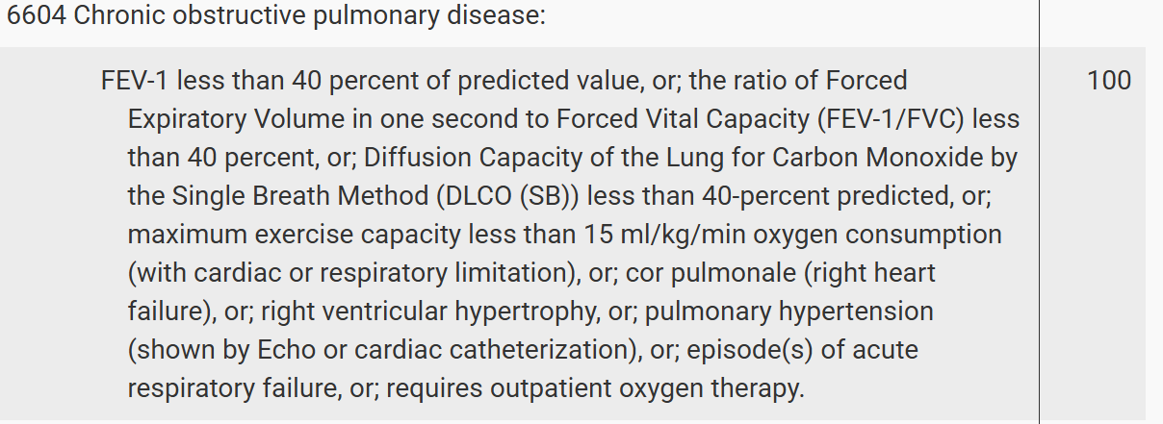

Claims
Claim sent up on 11/18/2025
Narrative/Code Sheet on 11/21/2025
Notification Letter on 11/25/2025

Slide 10
Audit Claims
Audit your claims!!!!!
Check C&P exams
Many answers lie in exams and Narratives
Claim Granted: Cool, is it correct?
Claim Denied: Lame, what did they do wrong?

Slide 11
Audit Claims
Mental Health and Migraines are common culprits
C&P exams sometimes have answers in their medical history

Slide 12
Audit Claims
Prostrating Definition: causing extreme exhaustion, powerlessness, debilitation or incapacitation with substantial inability to engage in ordinary activities
Migraines:
  1 characteristic prostrating attack per month is 30%
  1 or more completely prostrating attack per month with economic inadaptability is 50% – does it affect their work????

Slide 13
Audit Claims
Vet rated at 0% for headaches (C&P examiner marked “no” in symptoms checkboxes on DBQ)
In Section II Medical History of DBQ the examiner writes:
“HA…1-2x a week”
“he has to stop or slow down his work”
“Headaches occur every other day sometimes more than once a day…severe episodes will feel tired and uncomfortable”
APPEAL!!!!!!!!!!!!!!

Slide 14
Audit Claims
  Mental Health
    Suicidal Ideation
    Persistent danger of hurting yourself or others

Slide 15
Audit Claims
  HLR EXAMPLE ARGUMENT

Slide 16
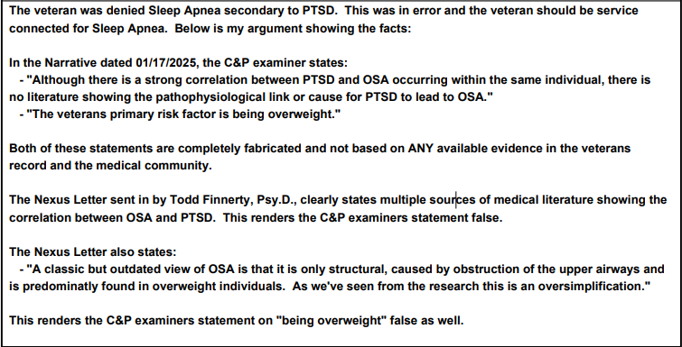

Slide 17
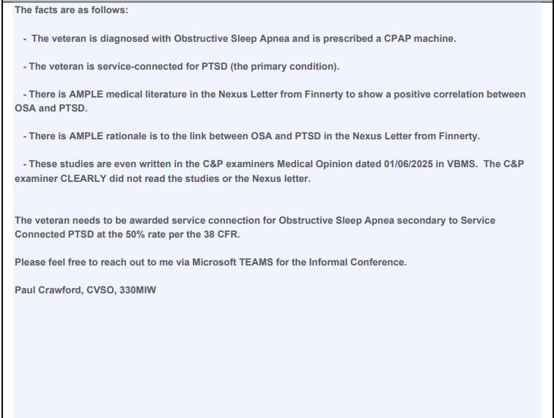

Slide 18

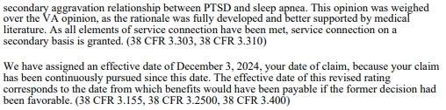
HLR Sent on 01/28/2025
Claim approved 50% OSA secondary to PTSD on 03/13/2025

Slide 19
BENefit of the doubt doctrine
38 U.S.C. § 5107(b): "When there is an approximate balance of positive and negative evidence regarding any issue material to the determination of a matter, the Secretary shall give the benefit of the doubt to the claimant."
38 C.F.R. § 3.102: "Reasonable doubt means one which exists because of an approximate balance of positive and negative evidence which does not satisfactorily prove or disprove the claim. It is a substantial doubt and one within the range of probability as distinguished from pure speculation or remote possibility."

Slide 20
Audit Claims
Check if your veteran has secondary conditions or Residuals
  SC Hypertension can lead to a BUNCH of different conditions and DIC for spouses
  Residuals of surgeries

Slide 21
Track your Claims
Check VBMS especially for development letters…usually dumb ones
Check dependents – look out for 21-0538’s!
  In school dependents – 21-674
  YOU CANNOT HAVE A DEPENDENT CHILD ON YOUR CLAIM AND CH 35 FOR THAT DEPENDENT AT THE SAME TIME

Slide 22
Questions or comments

